Slide 1


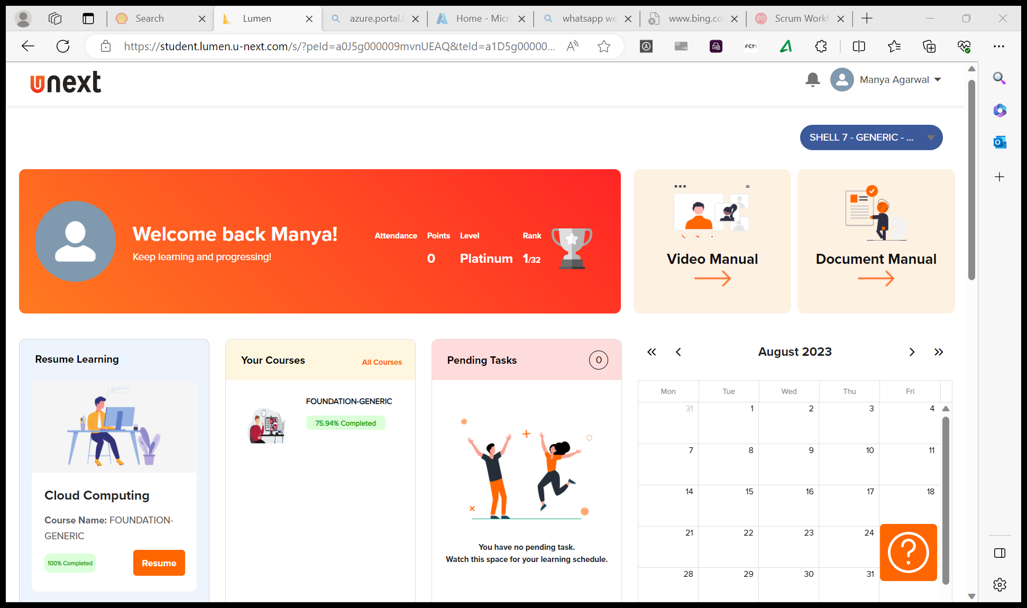
Journey Presentation
Submitted By:
Manya Agarwal
Employee No. : 654801

Slide 2
Journey Presentation Week-3

Slide 3
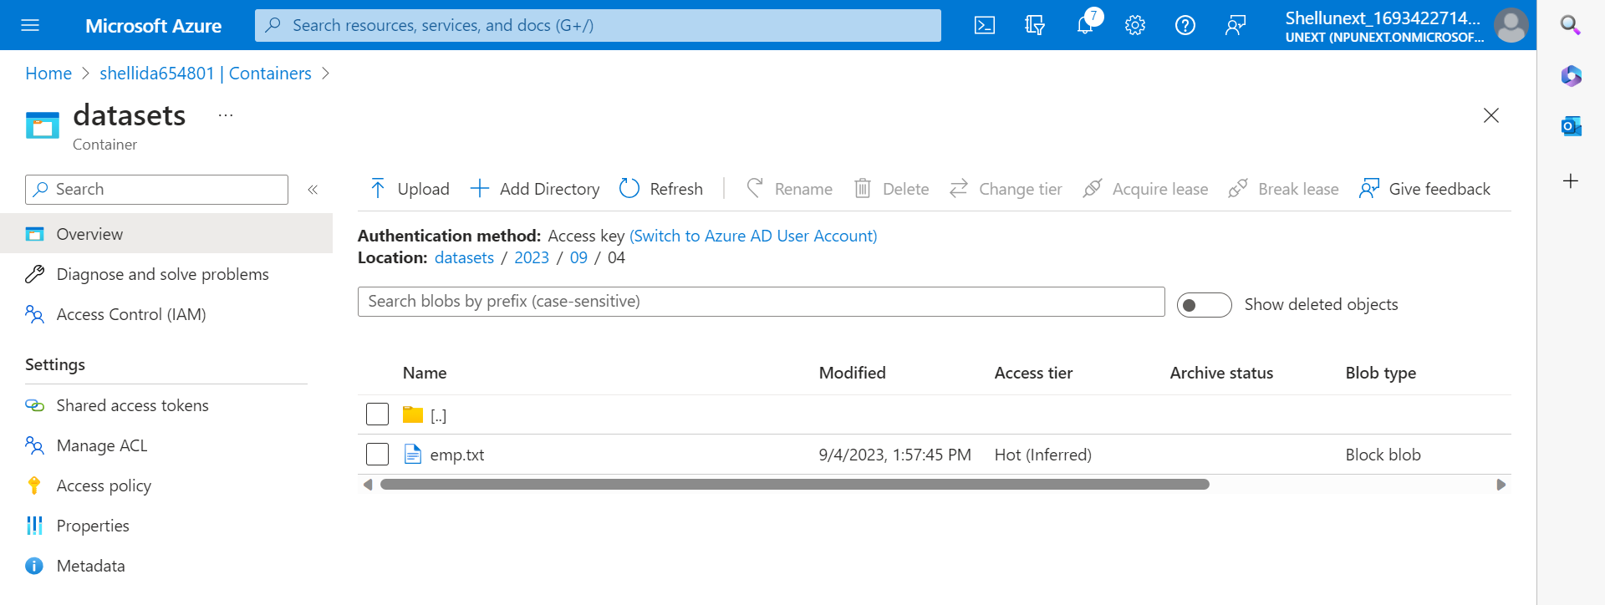
Day 12 : 4-Sep-23 (Monday) – Azure Storage Types
Azure data factory is cloud based ETL(extract, transform, load) service that allows us to create data-driven pipelines for orchestrating data movement and transforming data at scale.
Performed a group activity : Work with Azure Storage to explore redundancy options and storage tiers. You will start by creating an Azure Storage account and gaining an understanding of the available redundancy options, such as LRS, ZRS, GRS, and RA-GRS.
Successfully created Azure Storage Blob and dataset, Azure Data Lake storage, Queues, Fileshare, Table..

Slide 4
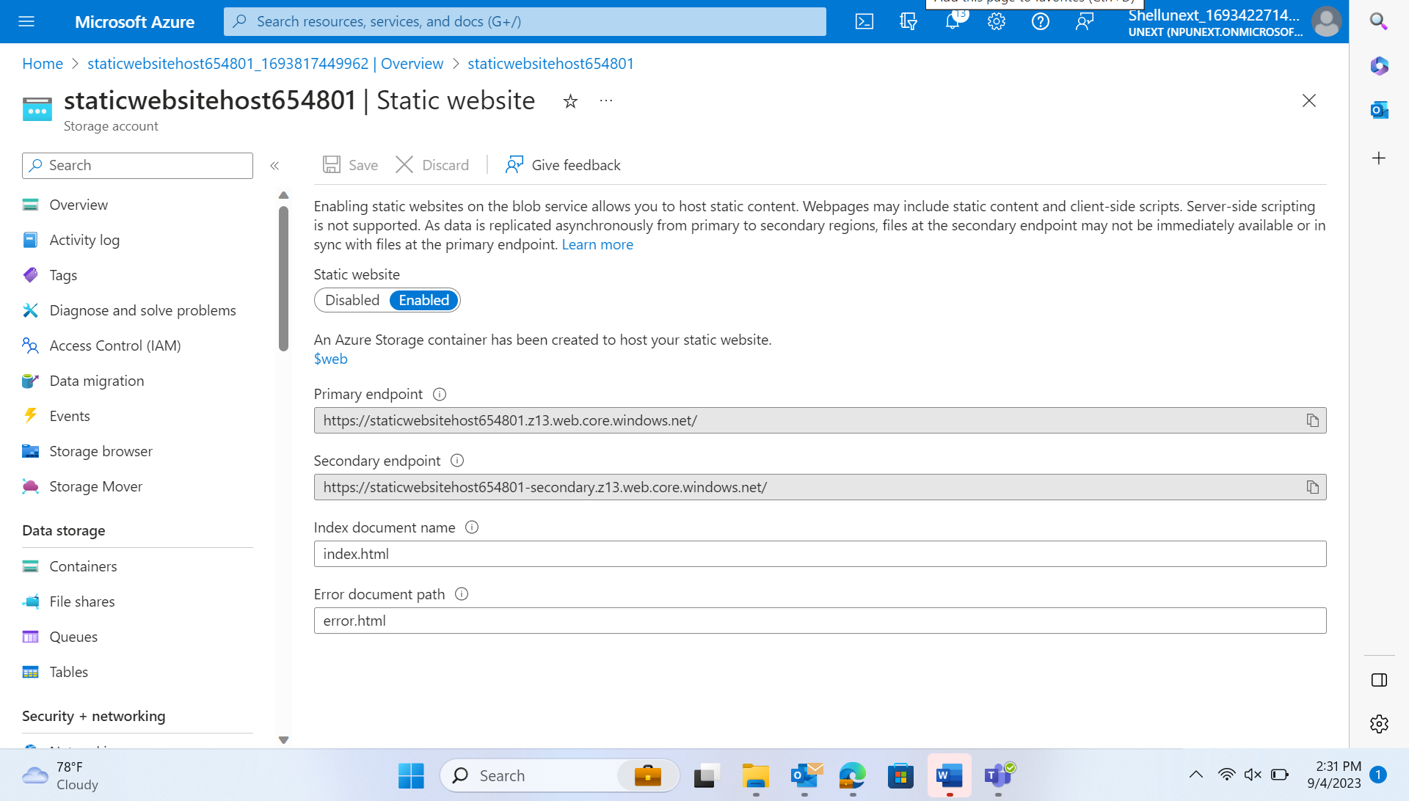
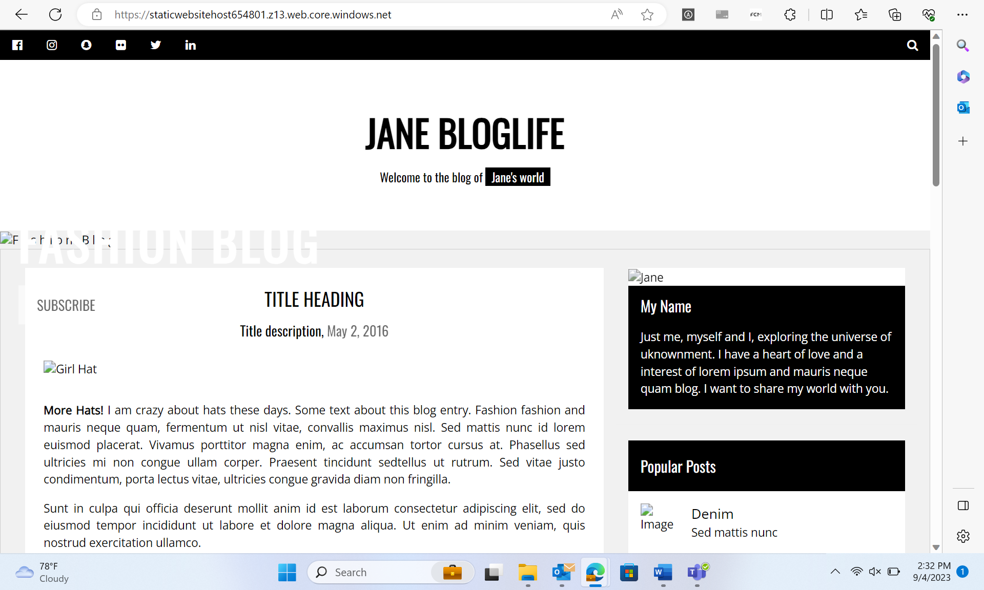
Day 12 : 4-Sep-23 (Monday) – Azure Storage Types
Hosted a static website in Blob storage.

Slide 5
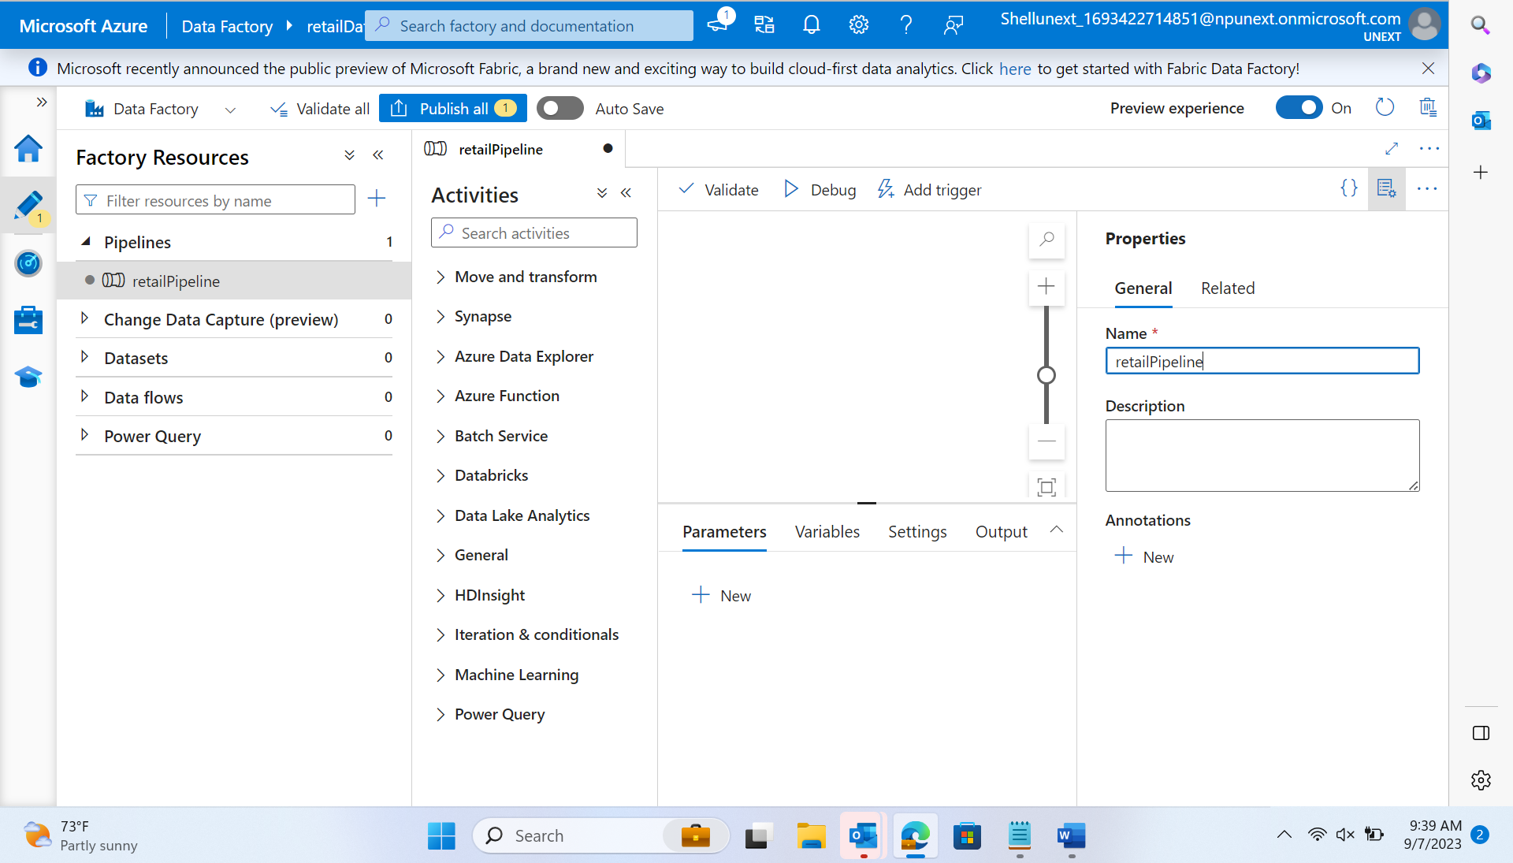
Day 13 : 5-Sep-23 (Tuesday) – Azure Storage Types + Data Factory
SSIS – SQL Server Integration Service
SSAS – SQL Server Analytical Service
SSRS – SQL Server Reporting Service
Designed Pipelines

Slide 6
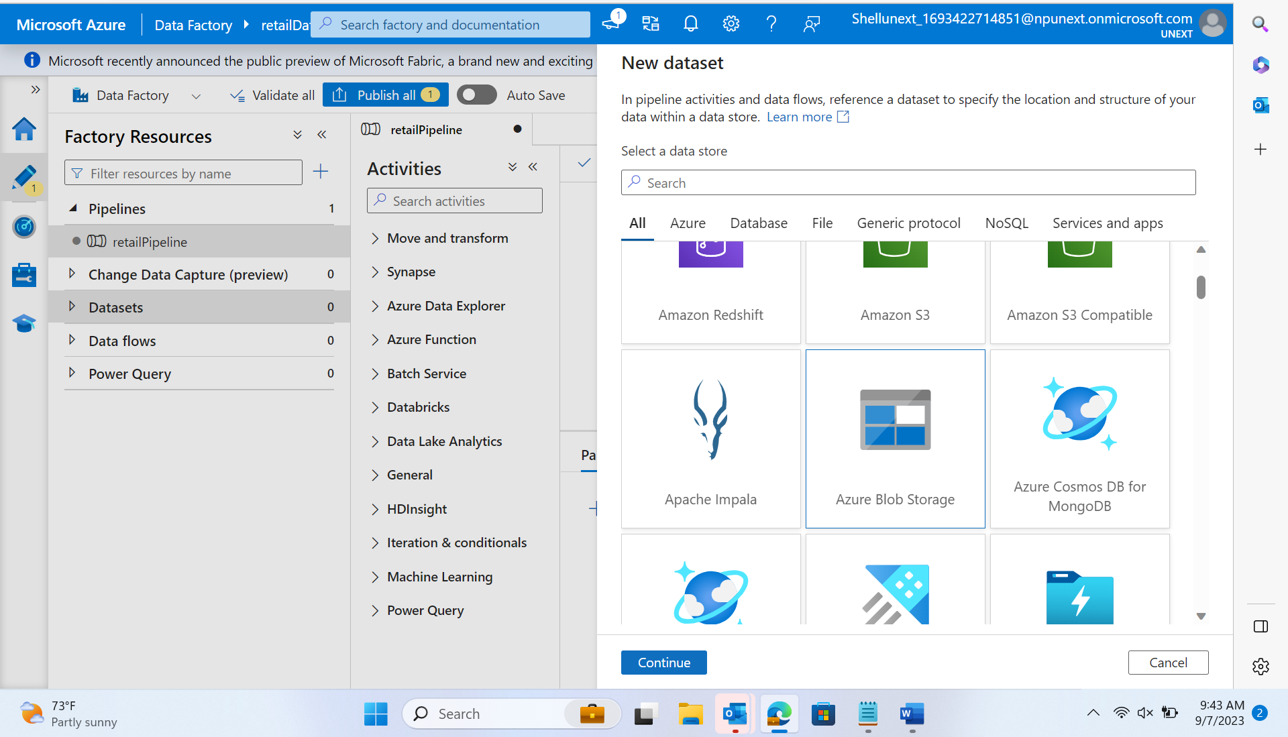
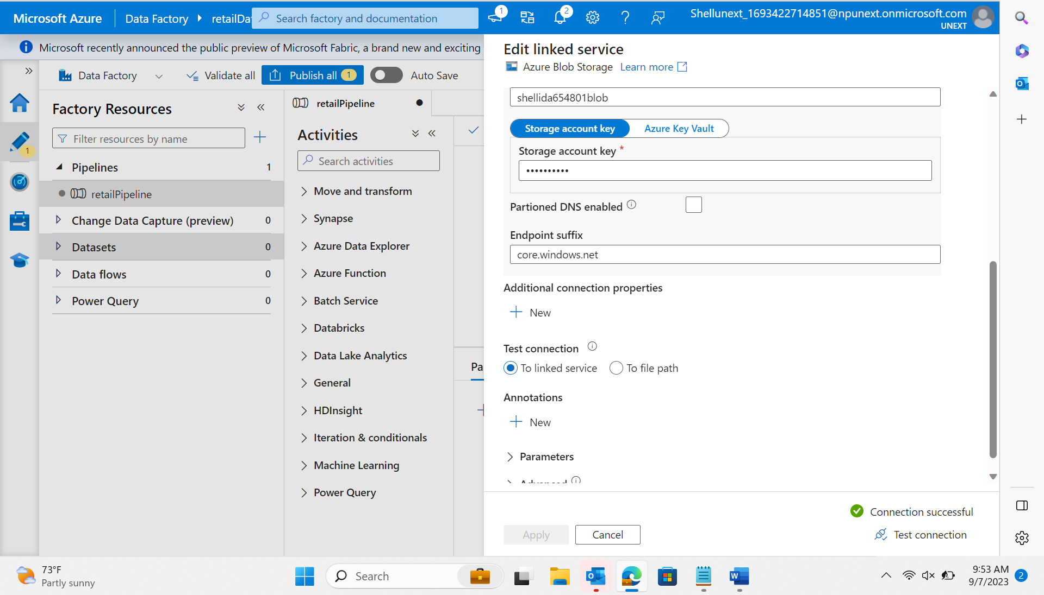
Day 13 : 5-Sep-23 (Tuesday) – Azure Storage Types + Data Factory
Datasets – source/target(sink)
Linked services – connection string

Slide 7
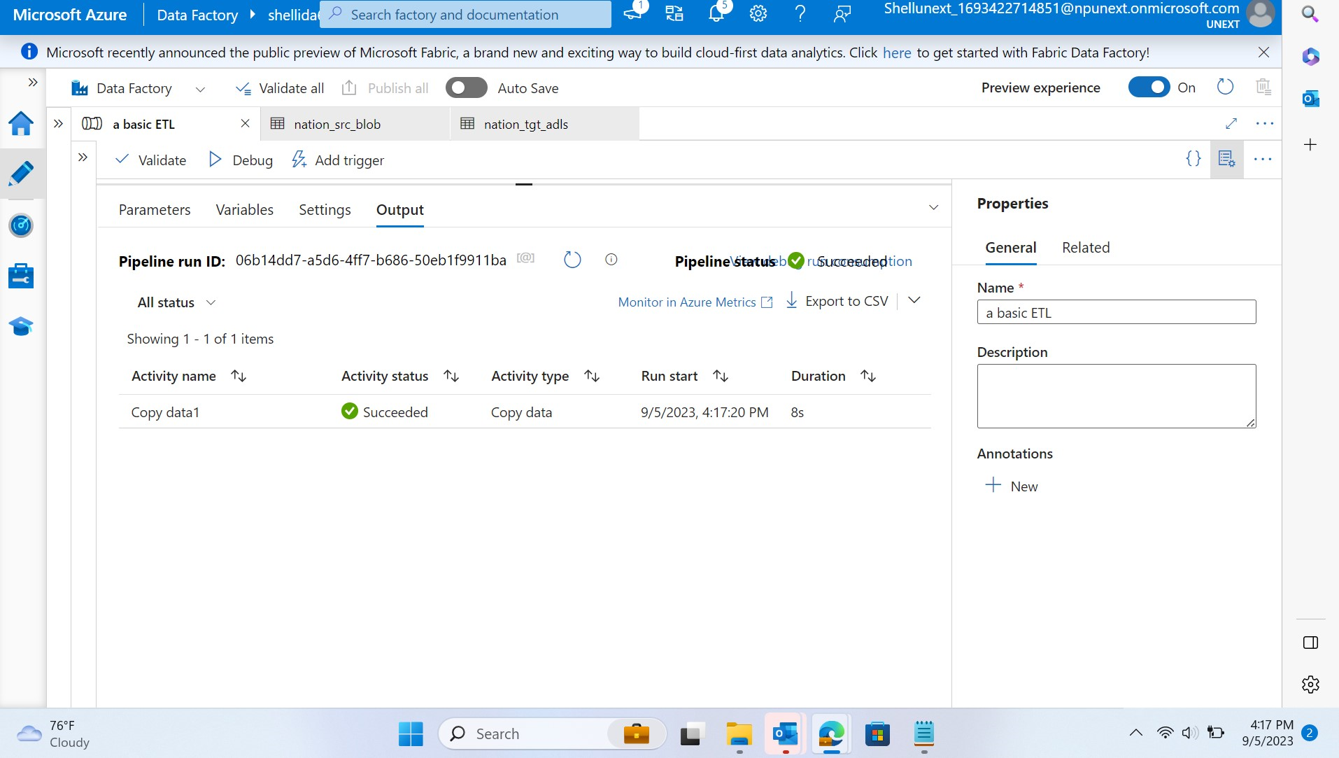
Day 13 : 5-Sep-23 (Tuesday) – Azure Storage Types + Data Factory
Azure blob src → azure data lake target using copy data activity
Low code no code – LCNC

Slide 8
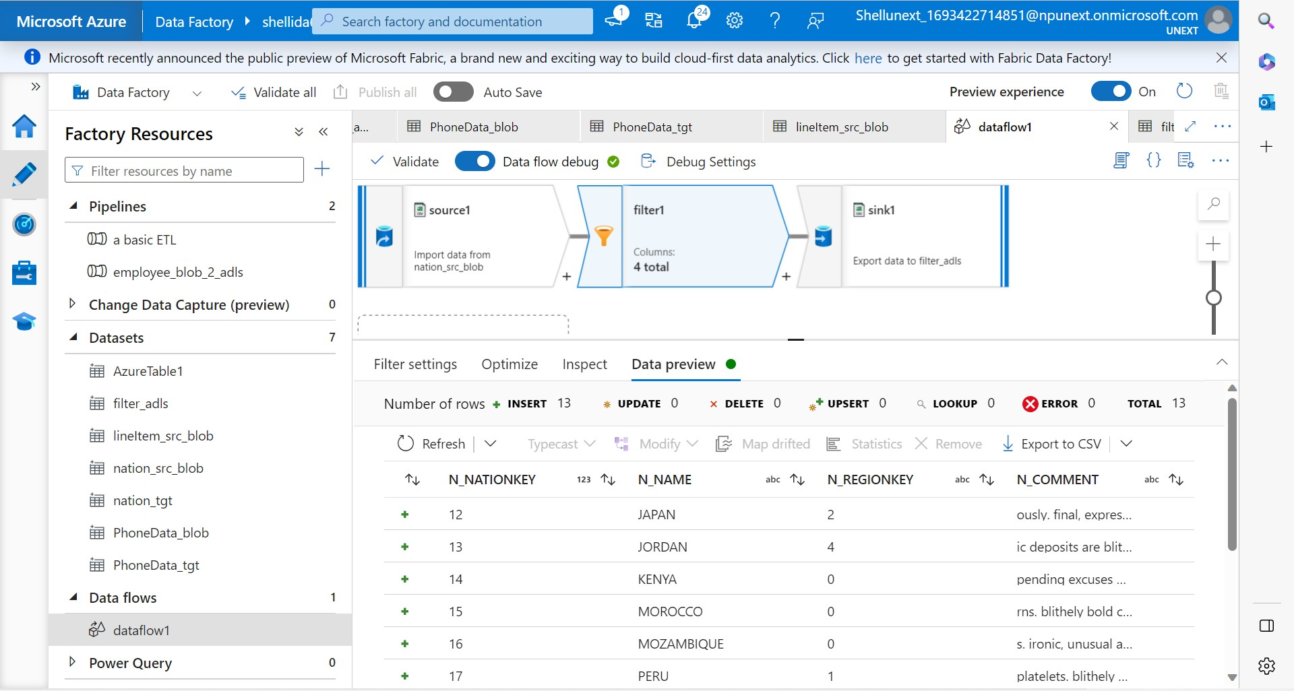
Day 14 : 6-Sep-23 (Wednesday) – Azure Data
Get metadata, Filter → control flow filter → takes array as input from other activity
Dataflow → source, sink, and filter transformation on nation key.

Slide 9
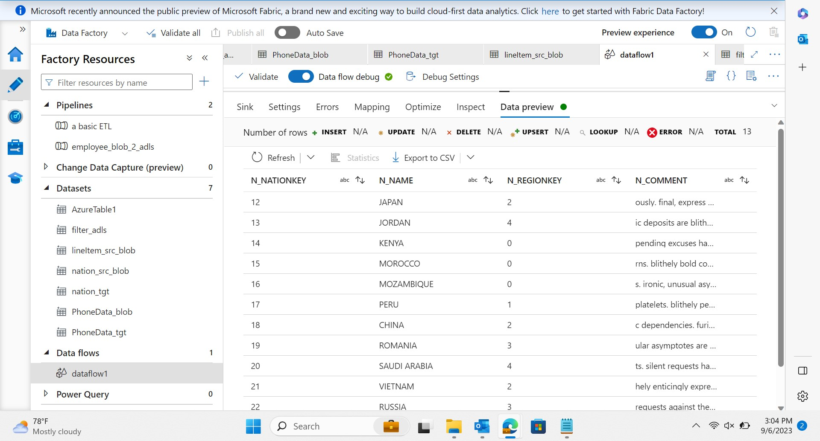
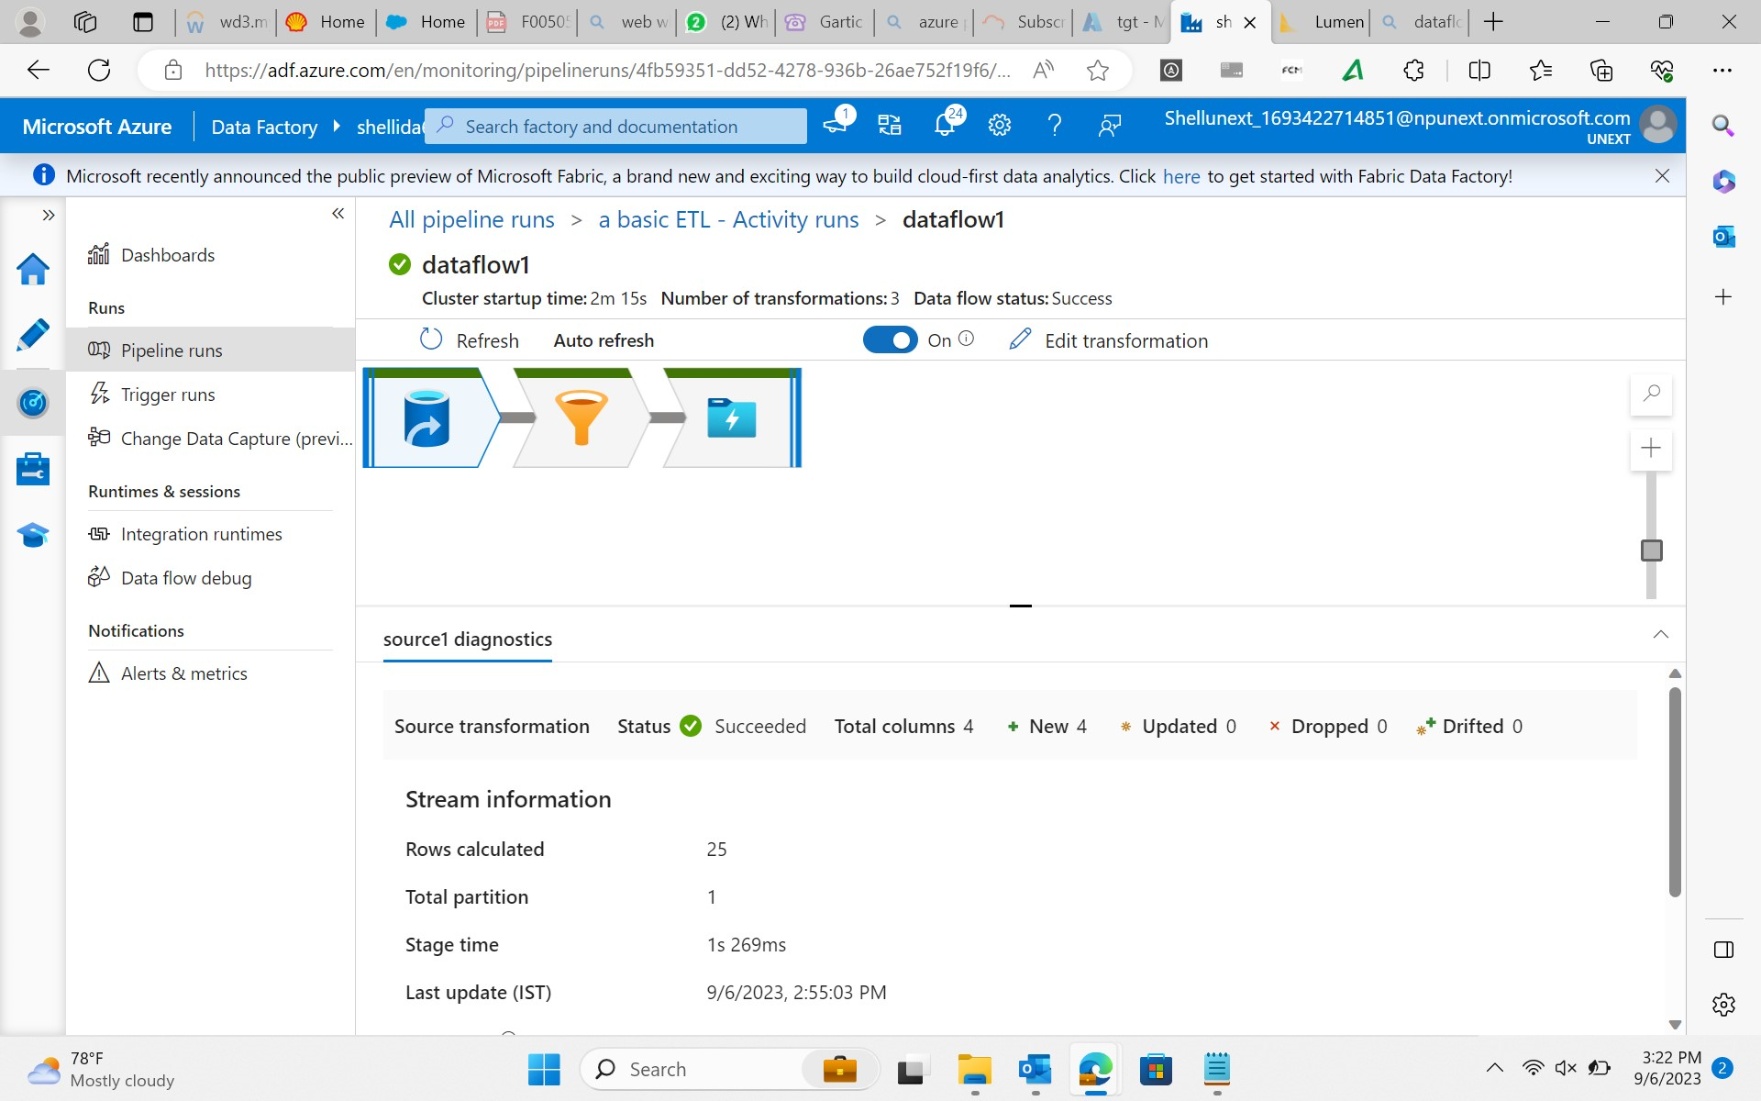
Day 14 : 6-Sep-23 (Wednesday) – Azure Data Factory
Filtered data

Slide 10
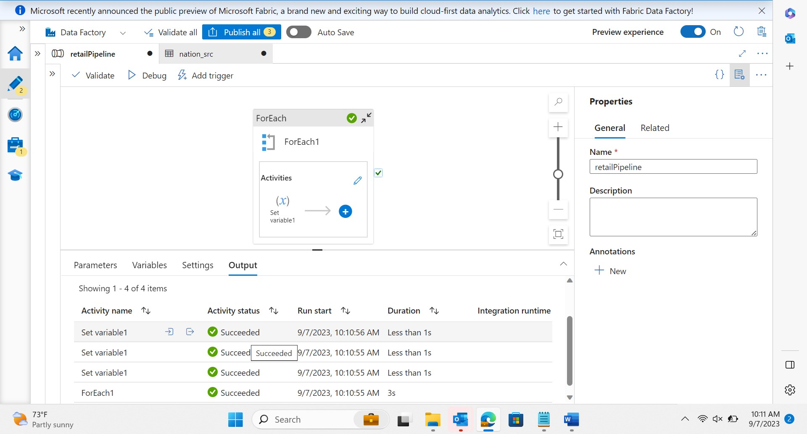
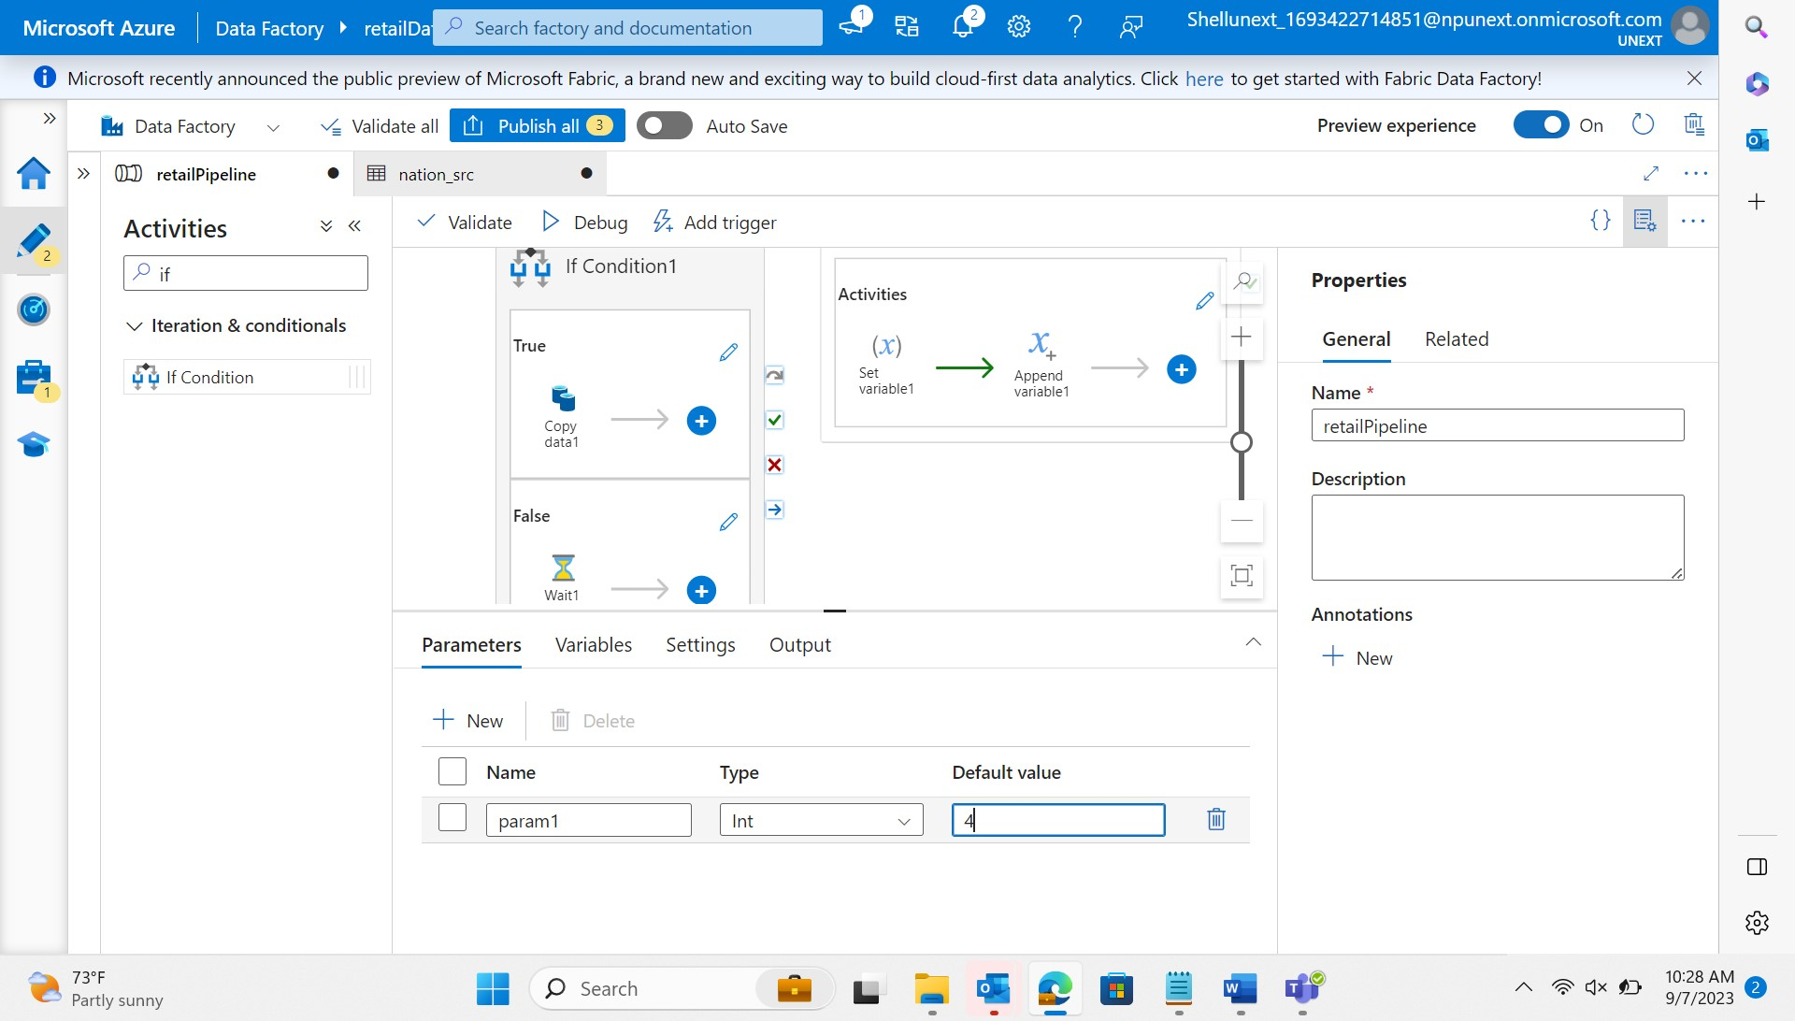
Day 15 : 7-Sep-23 (Thursday) – Azure Data Factory
Control Flow :
Foreach
If/wait/set variable/append variable

Slide 11
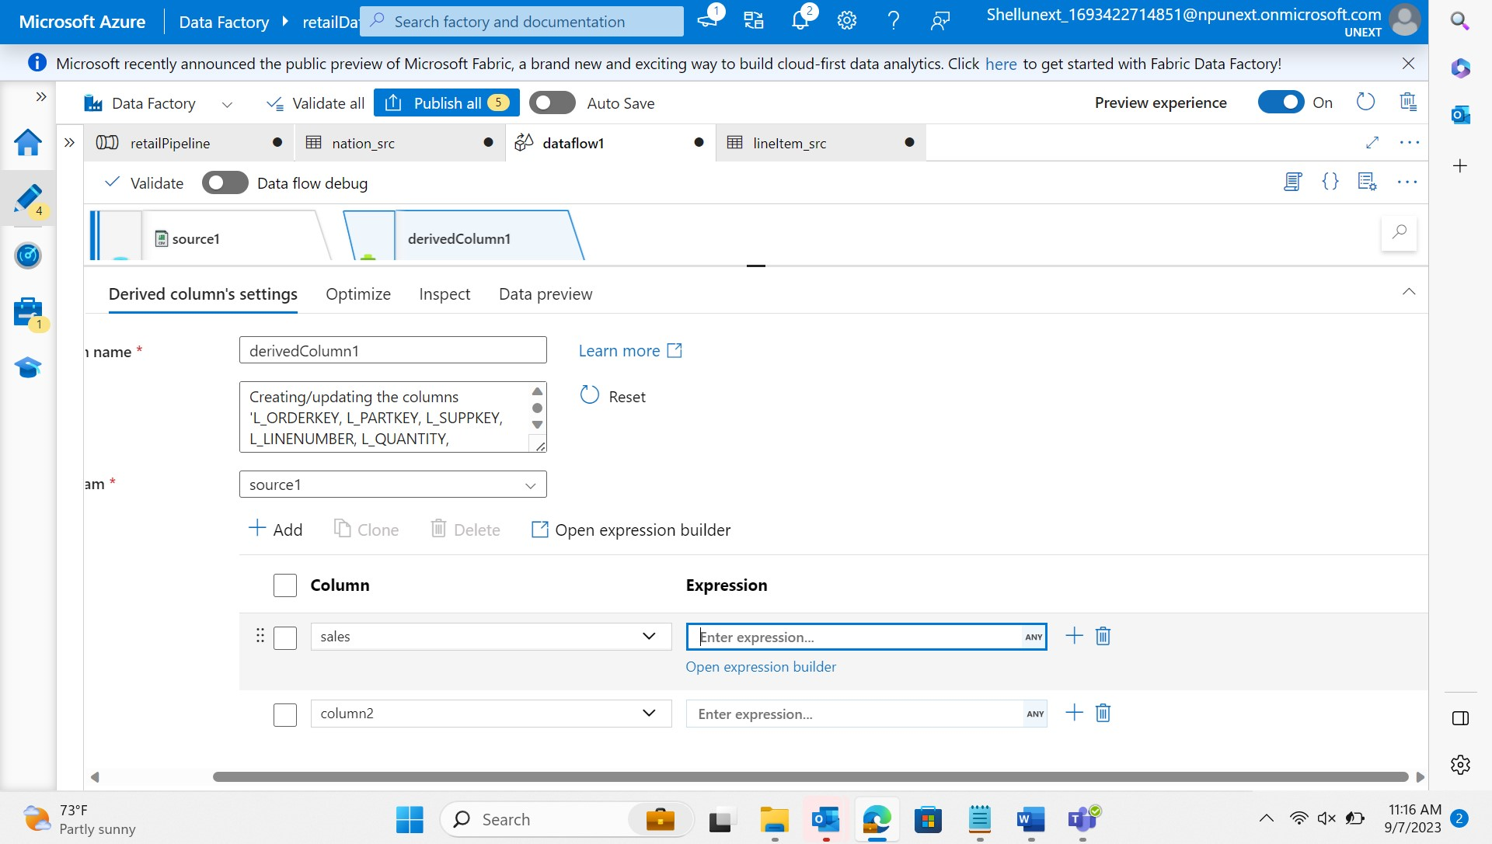
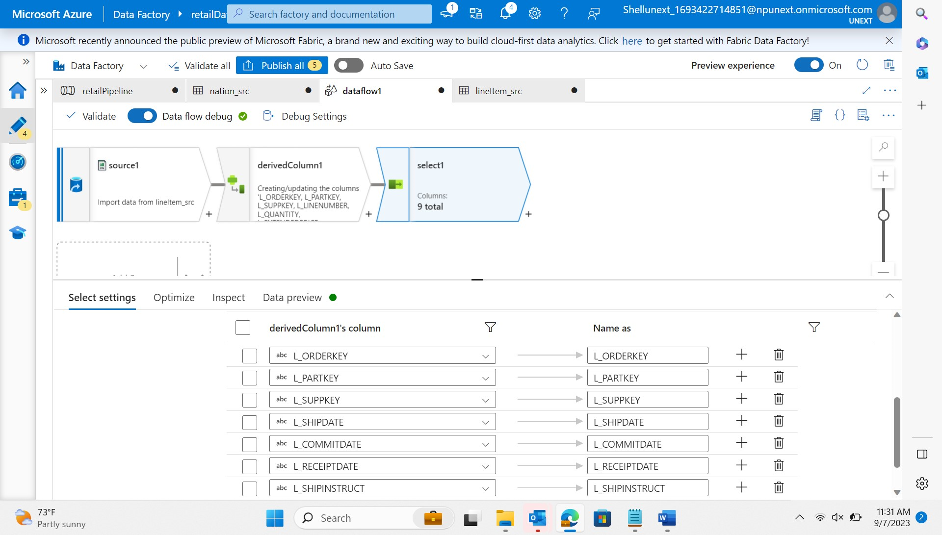
Day 15 : 7-Sep-23 (Thursday) – Azure Data Factory
Data Flow :
Derived Column
Select/filter columns

Slide 12
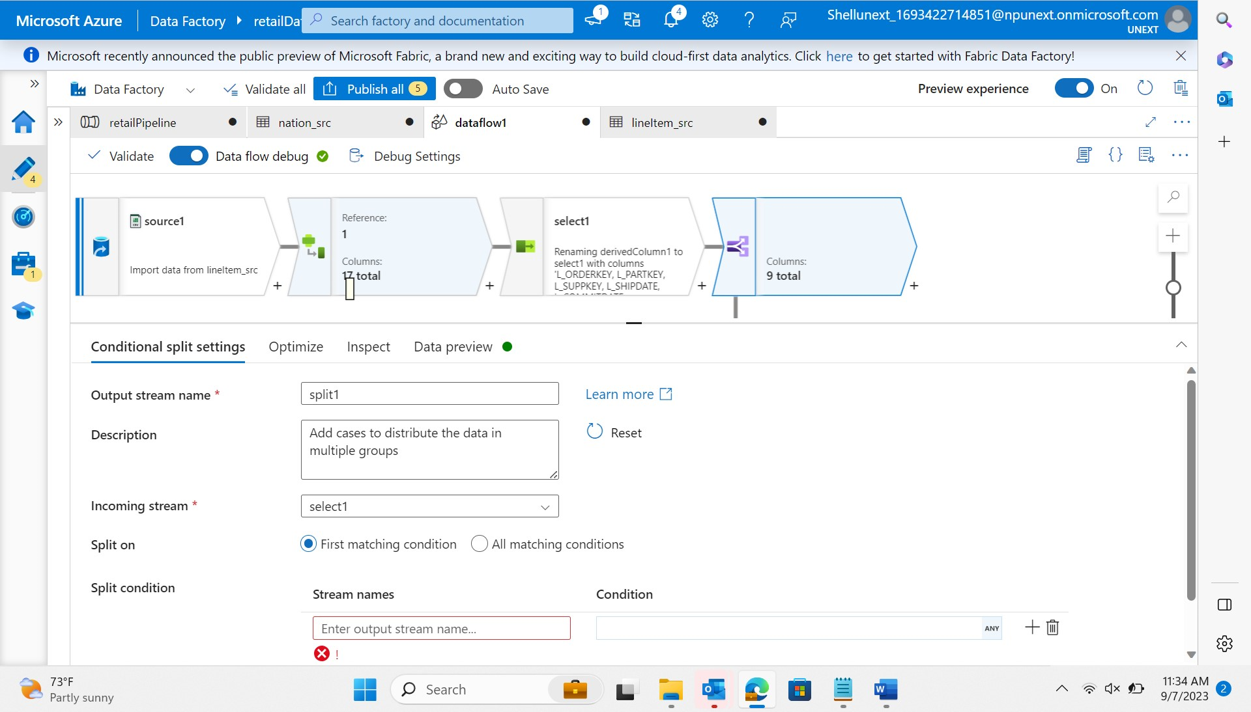
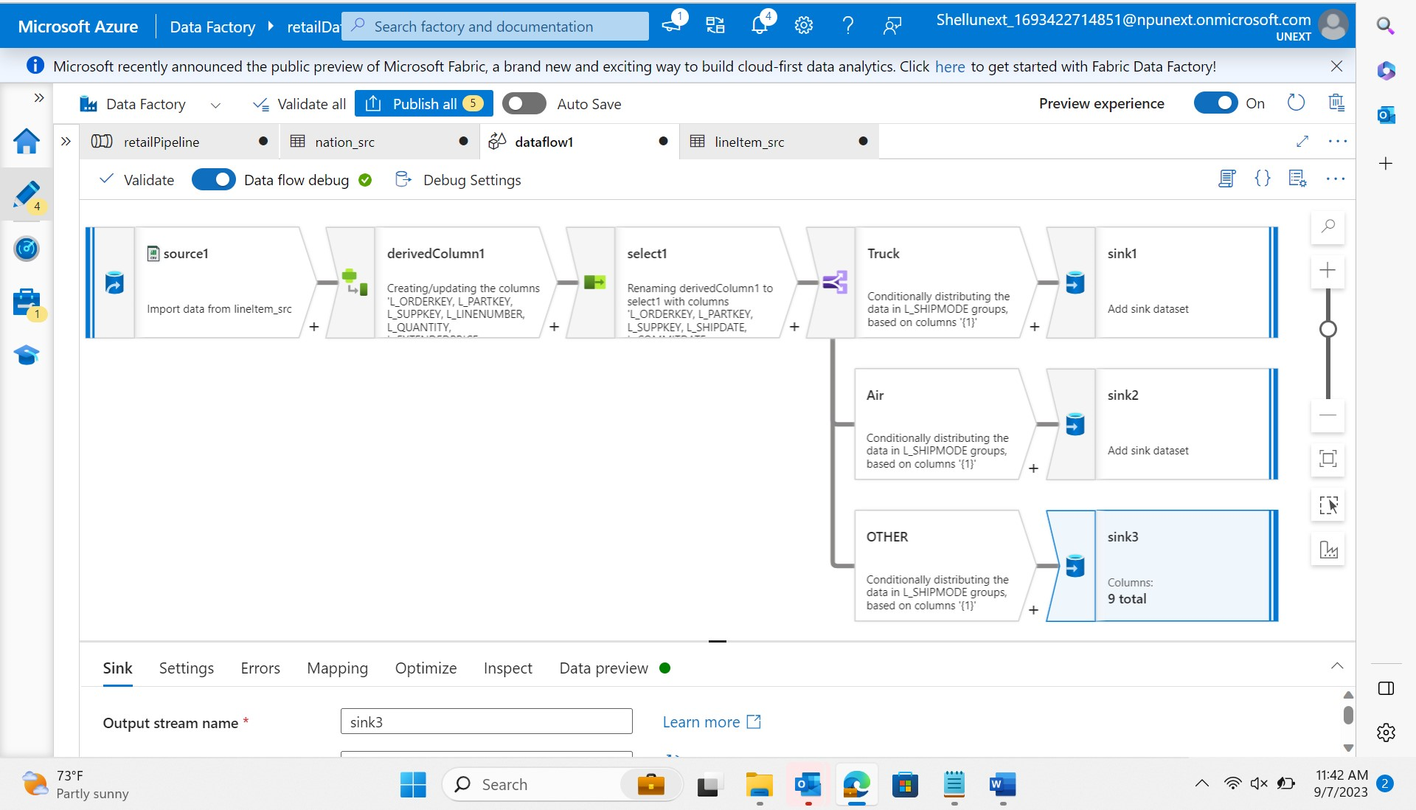
Day 15 : 7-Sep-23 (Thursday) – Azure Data Factory
Data Flow :
Conditional split
sink

Slide 13
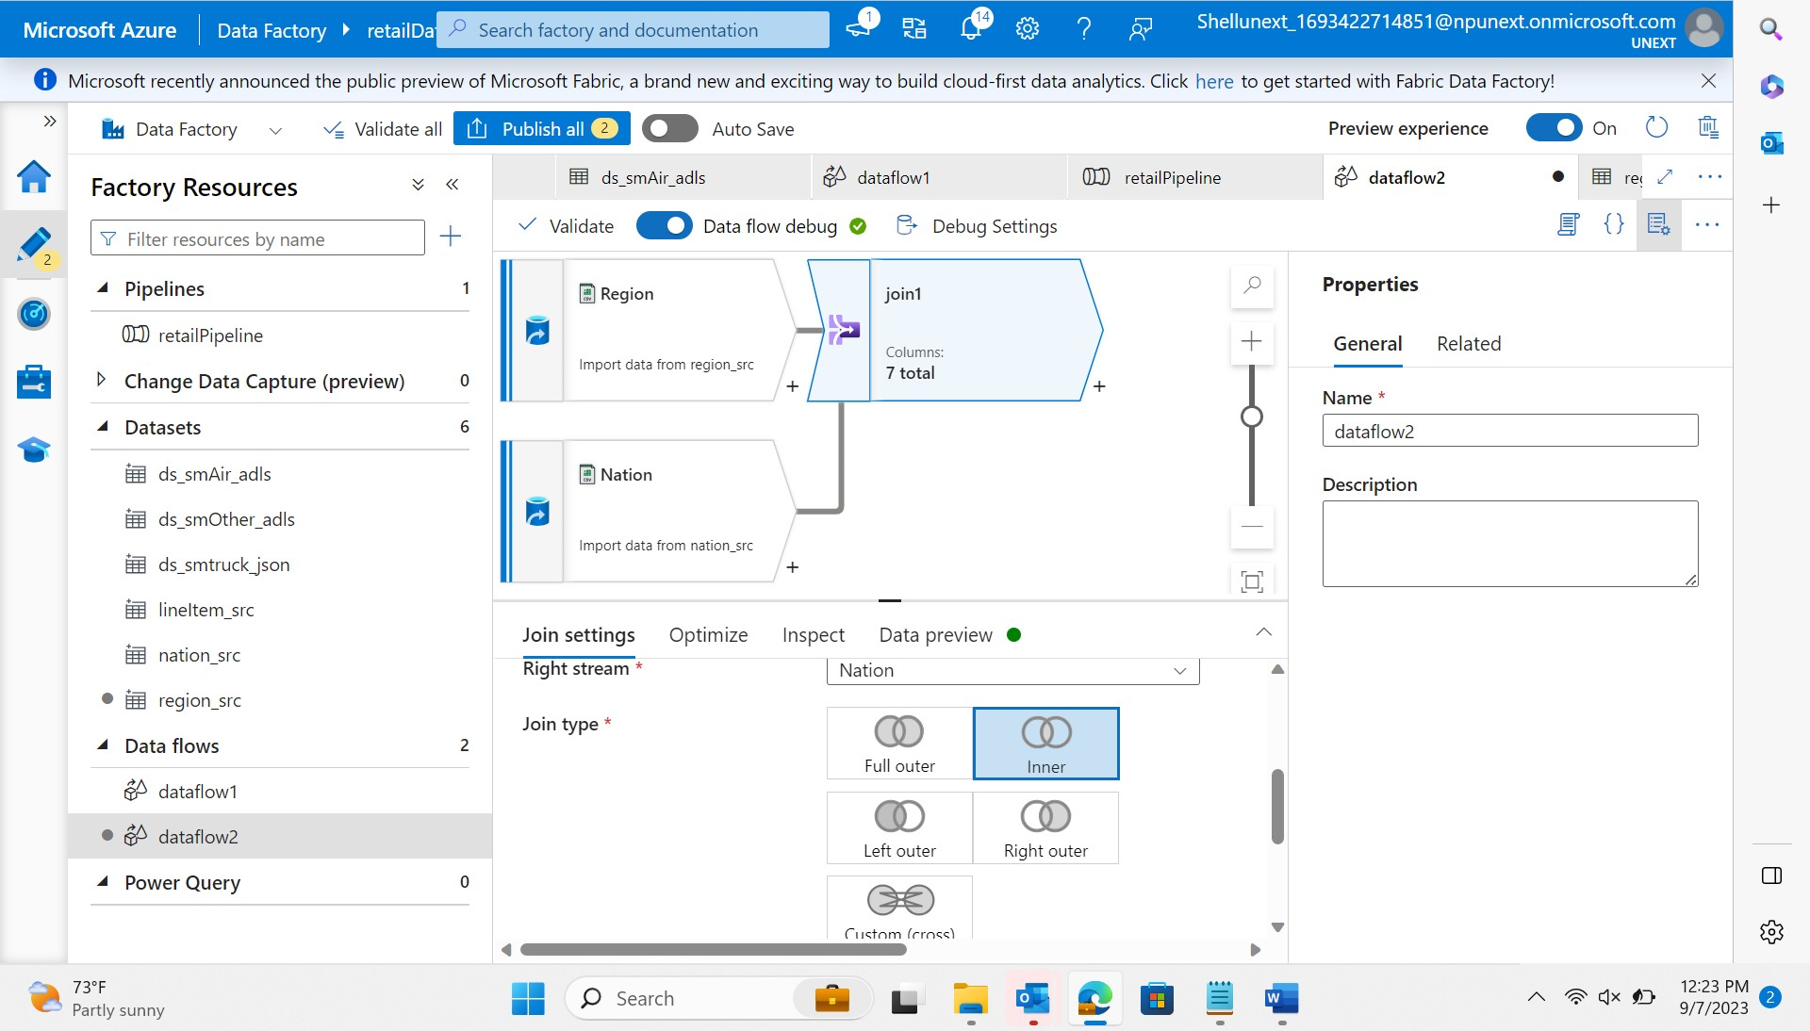
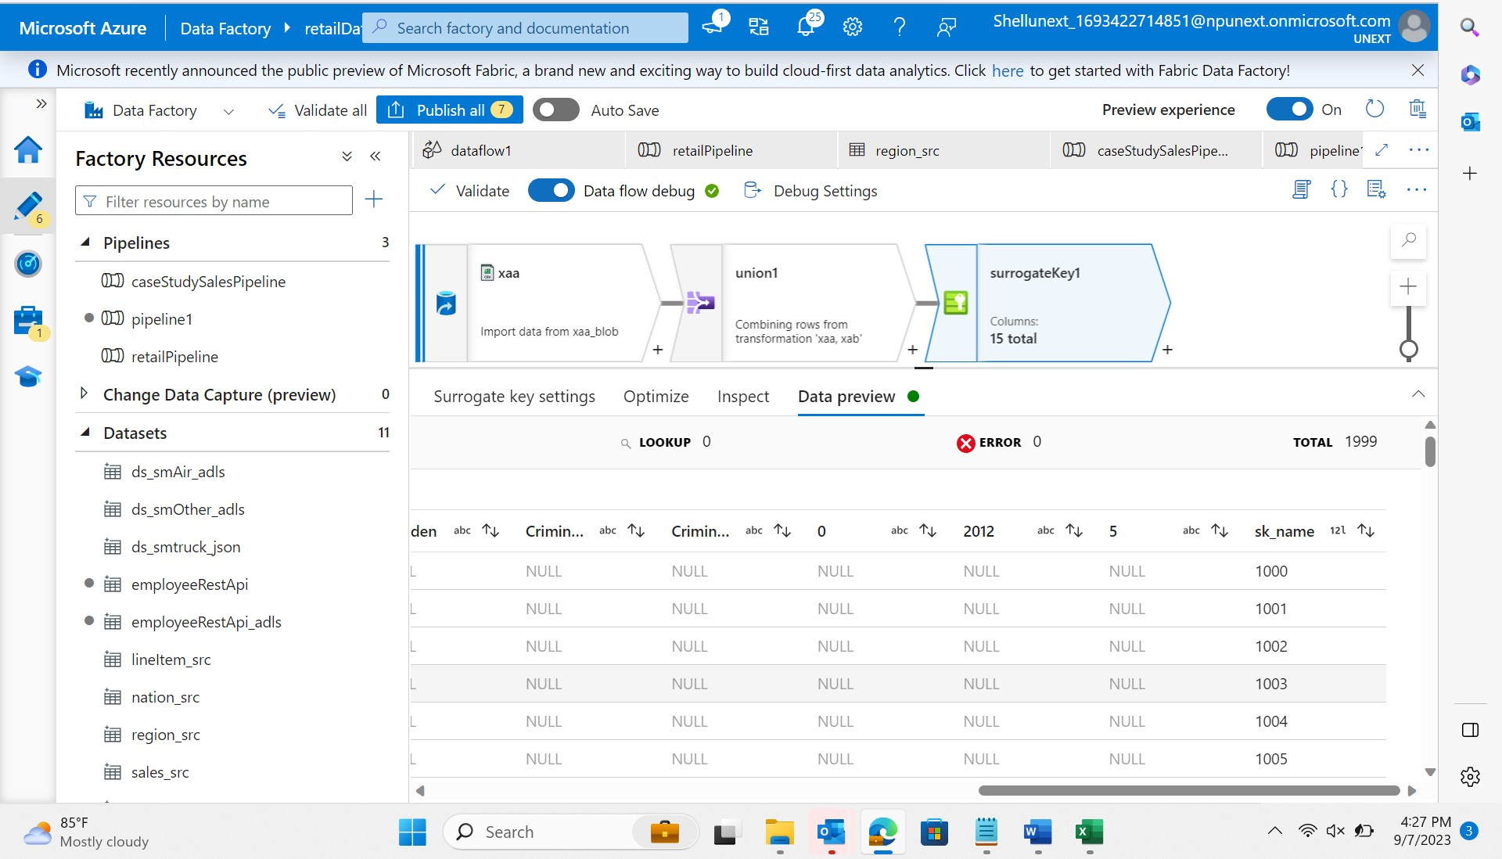
Day 15 : 7-Sep-23 (Thursday) – Azure Data Factory
Data Flow :
Join
Union and Surrogate key

Slide 14
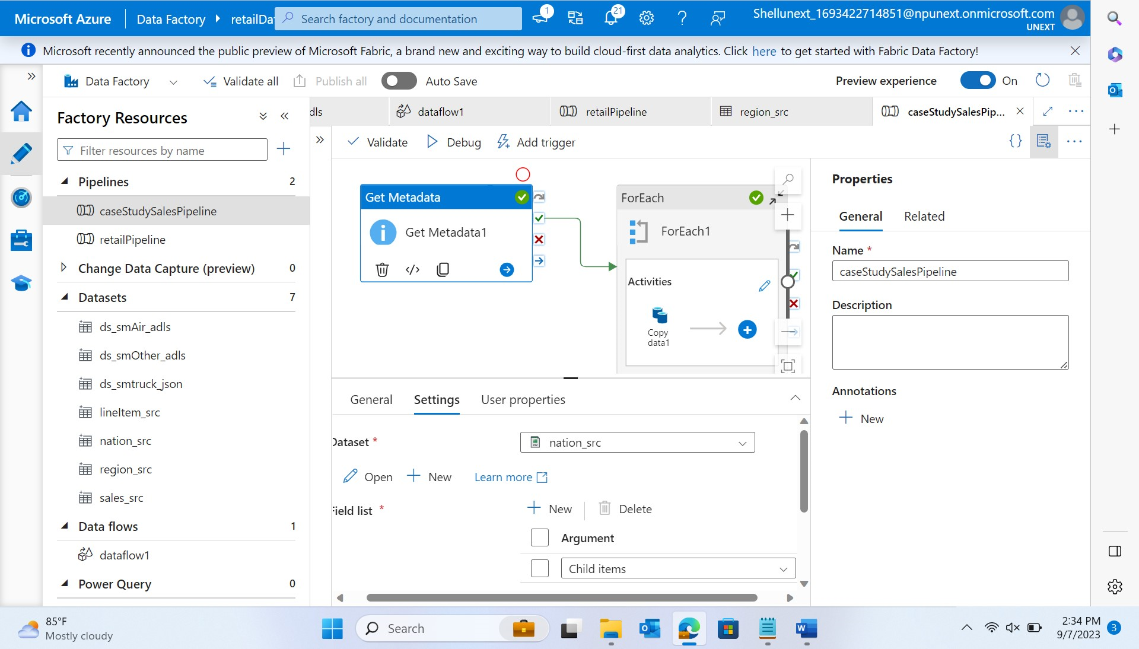
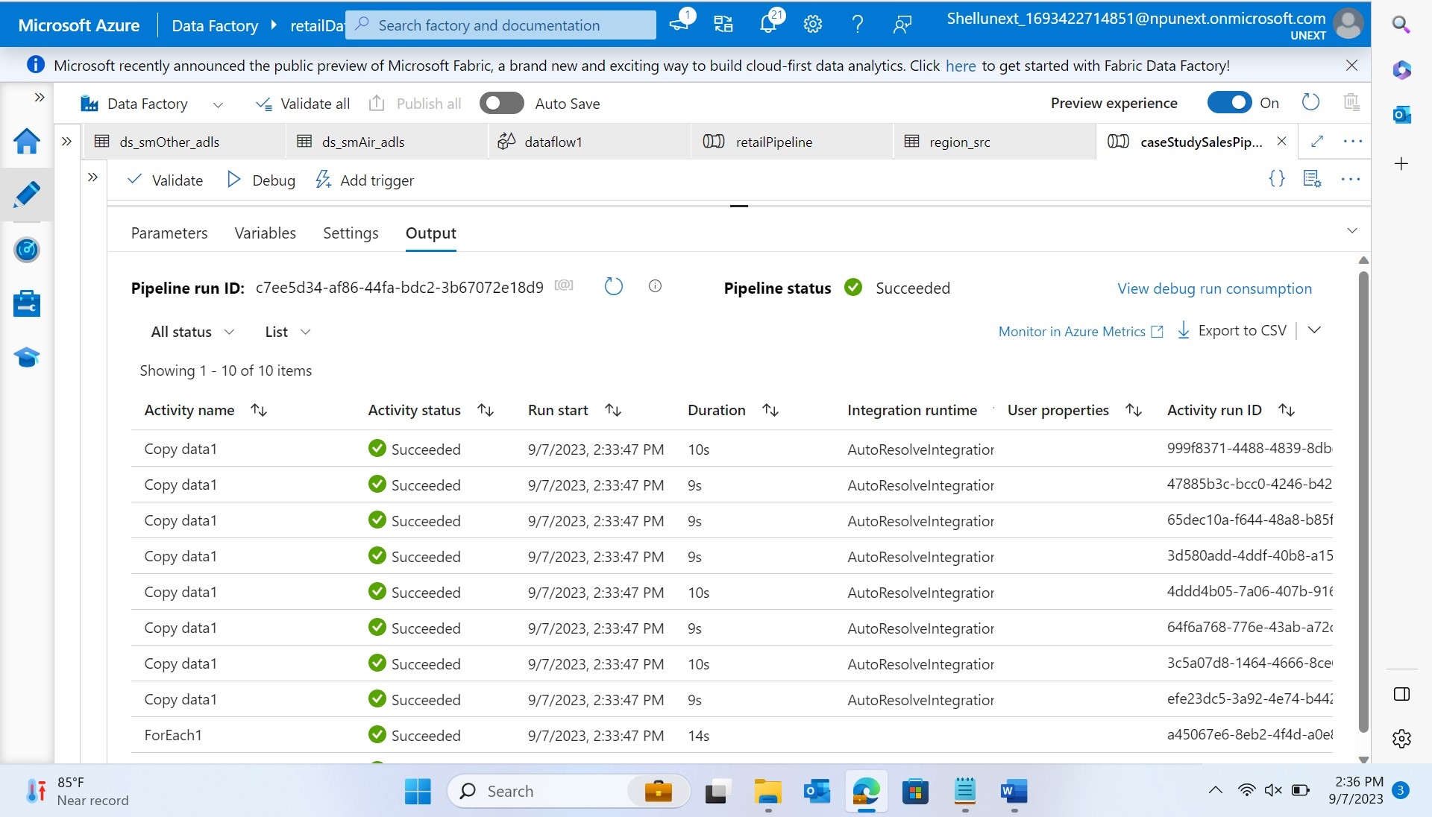
Day 15 : 7-Sep-23 (Thursday) – Azure Data Factory
Copy Data: Ingest the raw sales data from various sources (e.g., CSV files, databases) into Azure Data Lake Storage.

Slide 15
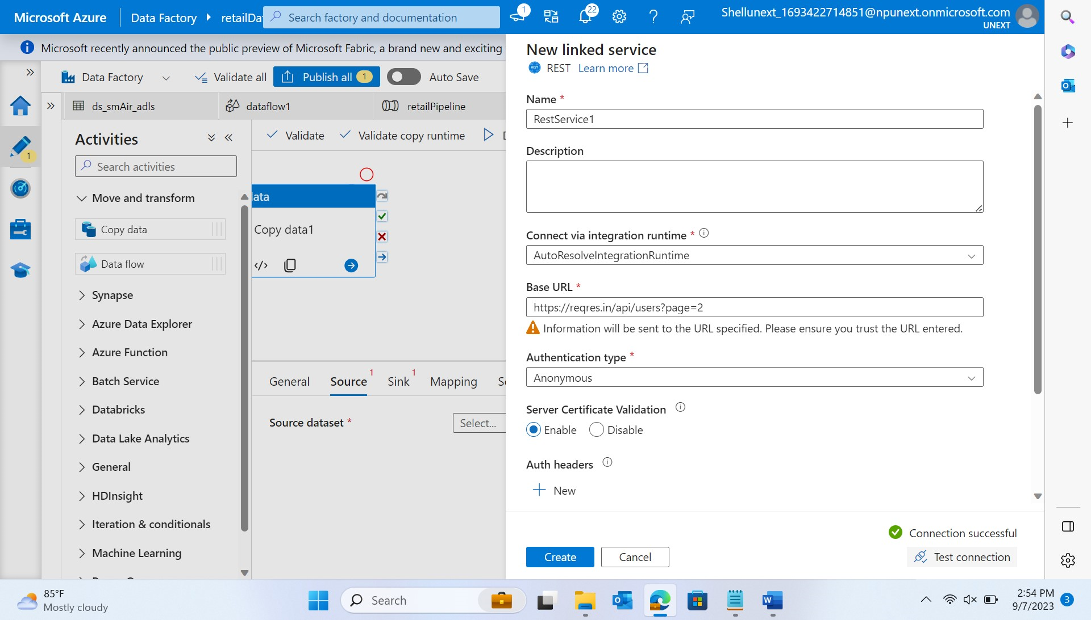
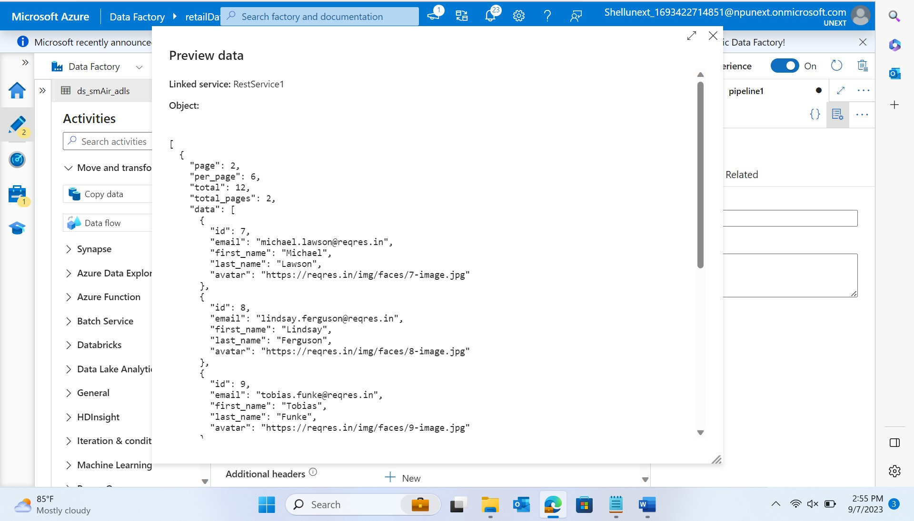
Day 15 : 7-Sep-23 (Thursday) – Azure Data Factory
Rest API → Source : Copy Data → Data Flow

Slide 16
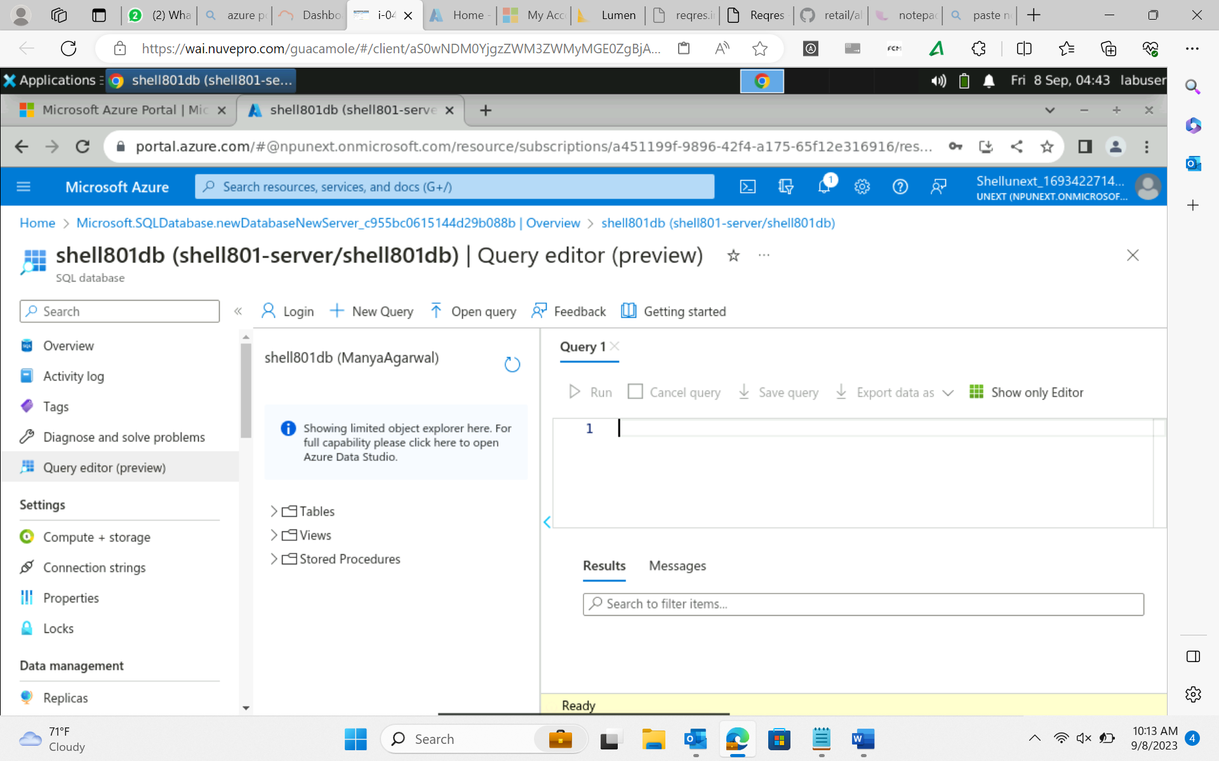
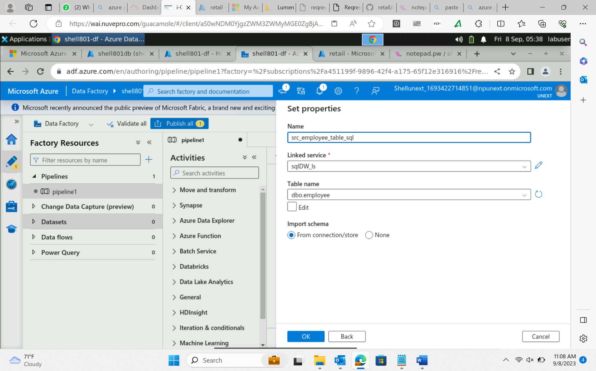
Day 16 : 8-Sep-23 (Friday) – Azure Data Factory
Realtime scenarios –
Data Migration – From the existing files, heterogeneous sources migrate the data to homogeneous DW or data mart.
Intermediate Stage Layers – We perform data cleansing, scrubbing and other transformation on the data before loading into DW/DM.
Azure data migration from on premises to cloud DW.

Slide 17
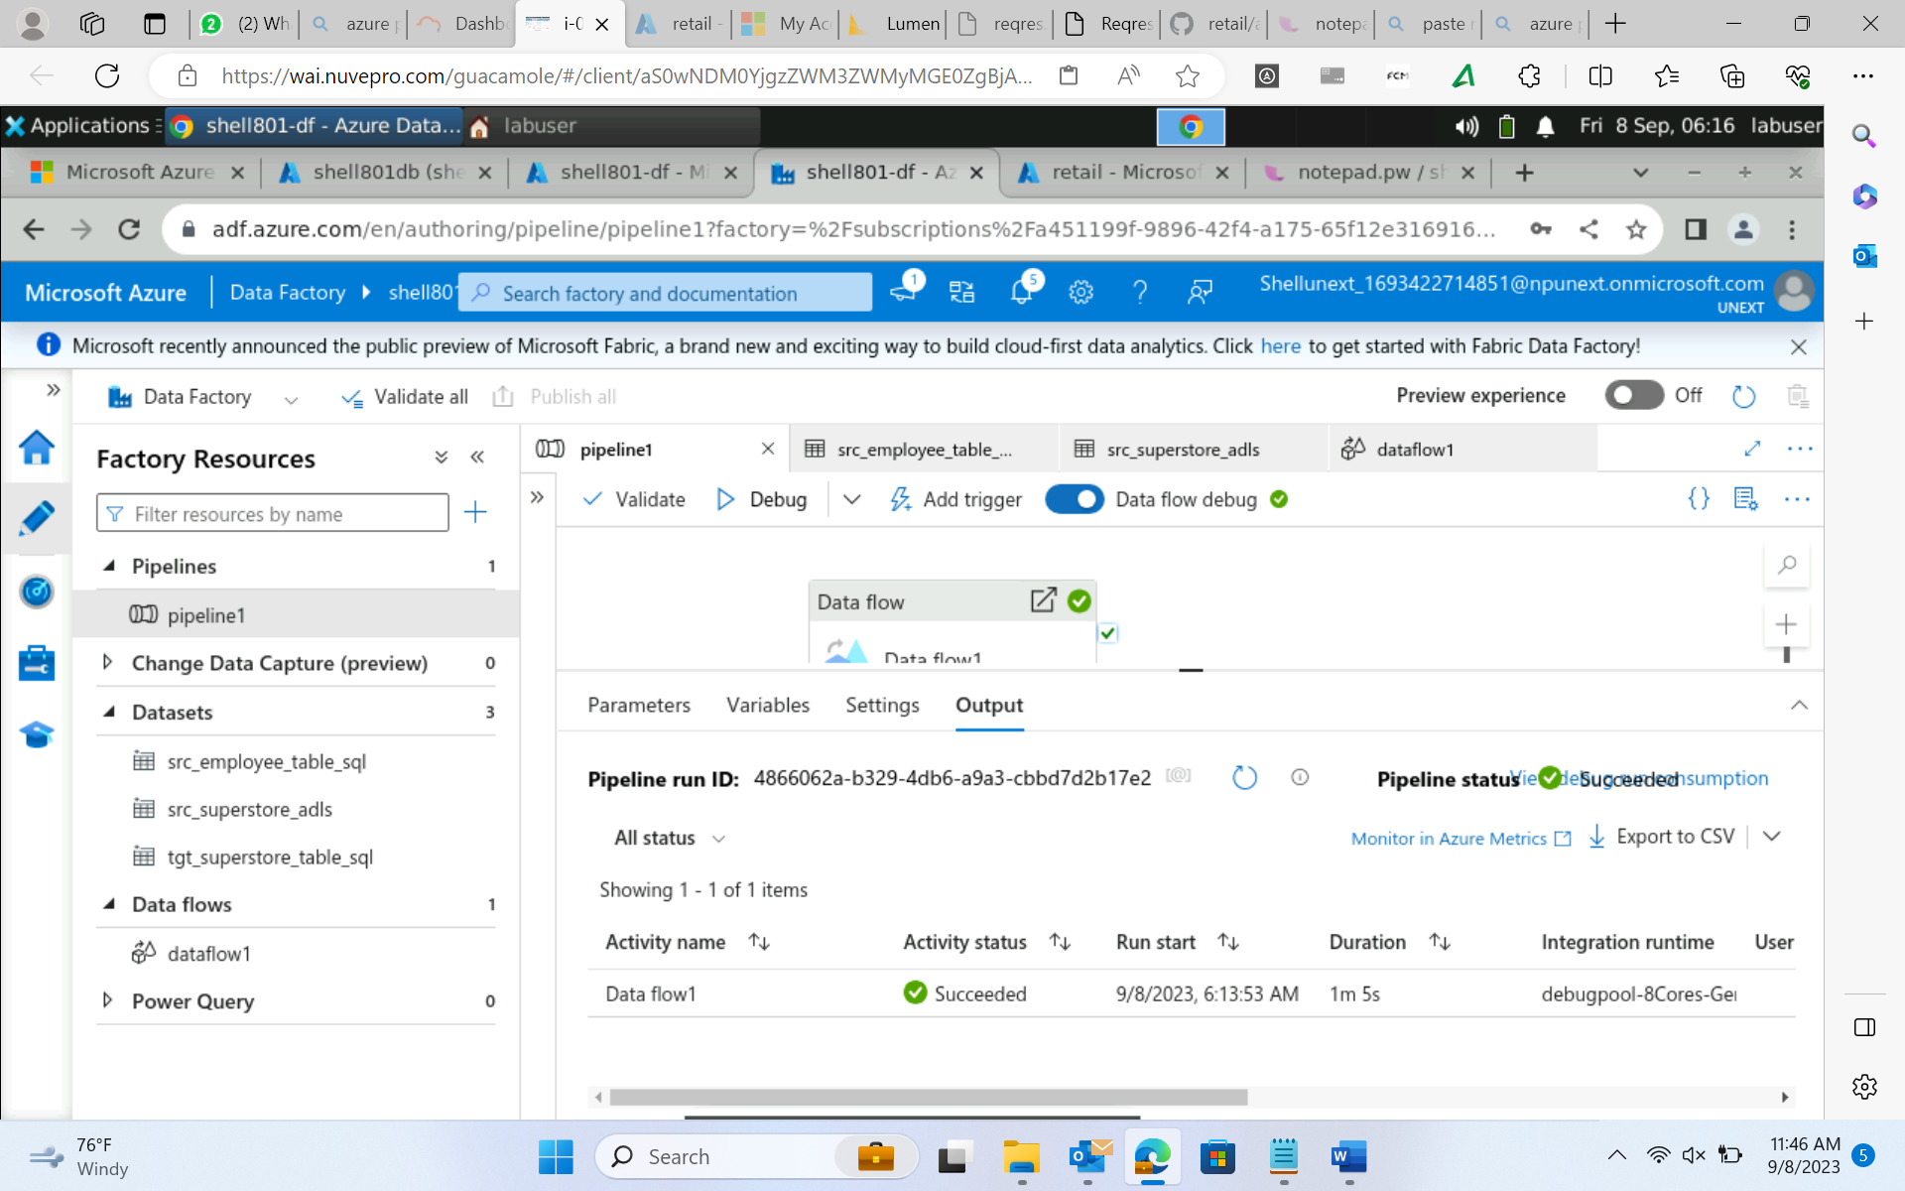
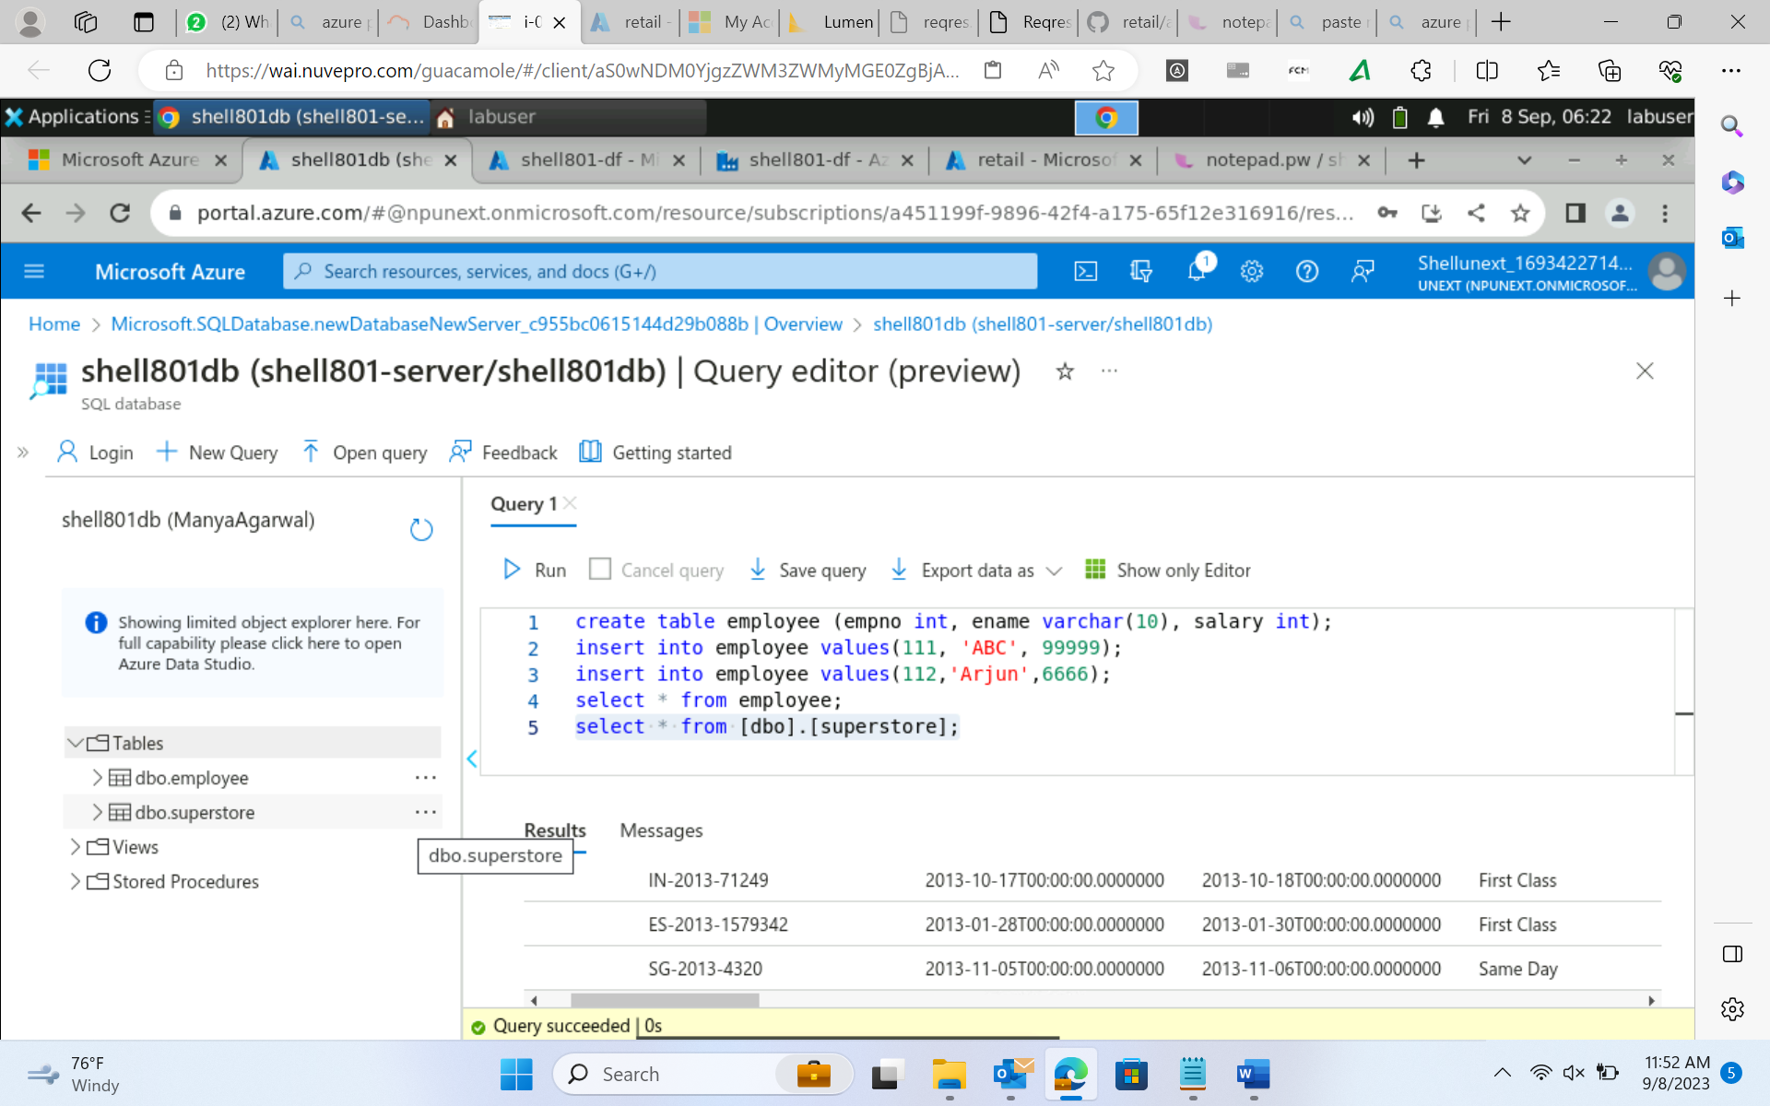
Day 16 : 8-Sep-23 (Friday) – Azure Data Factory

Slide 18
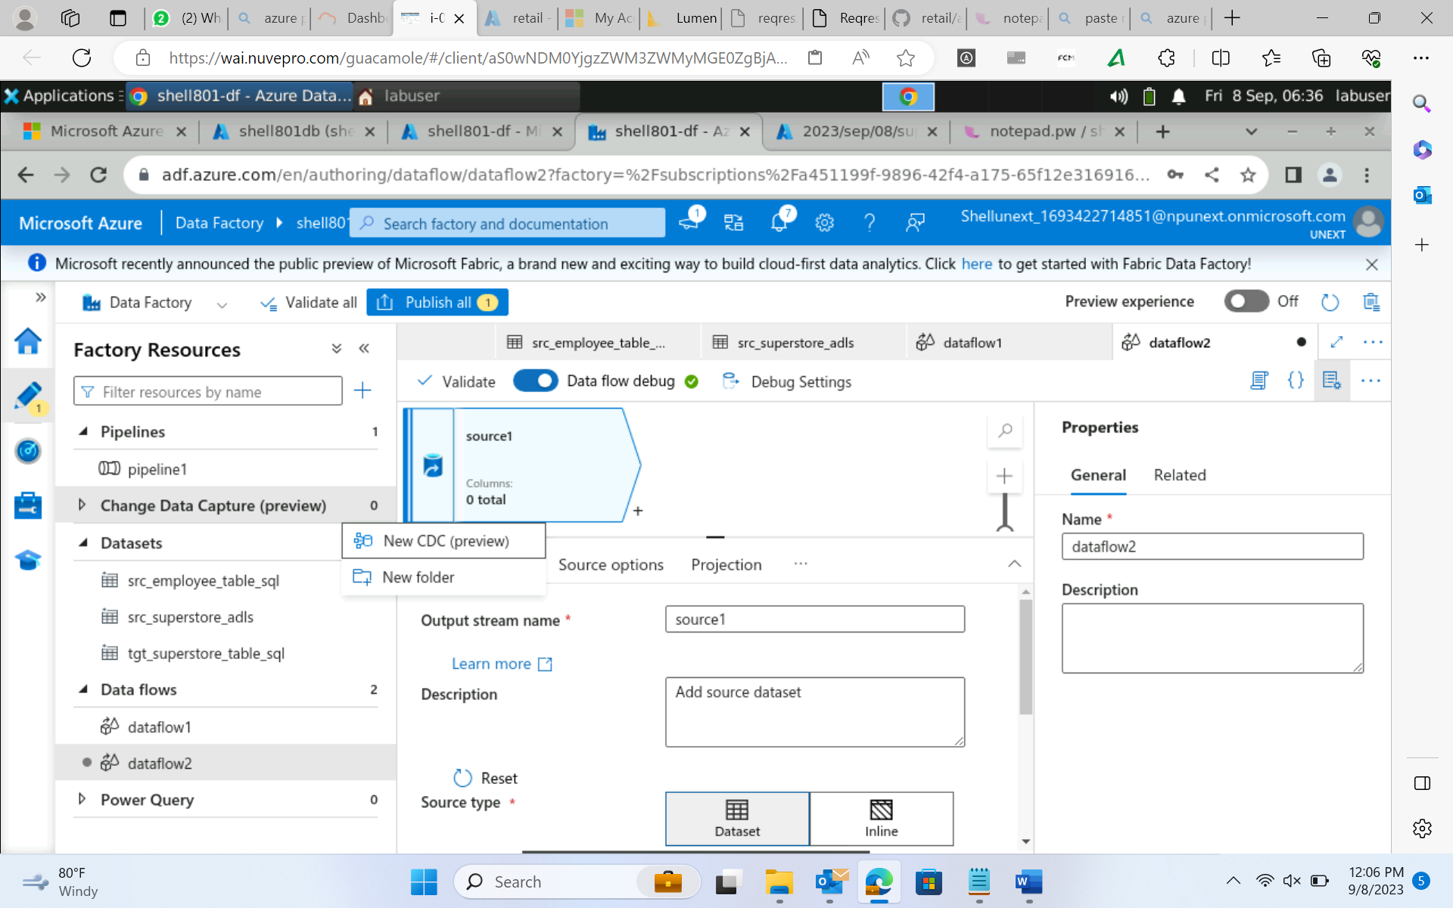
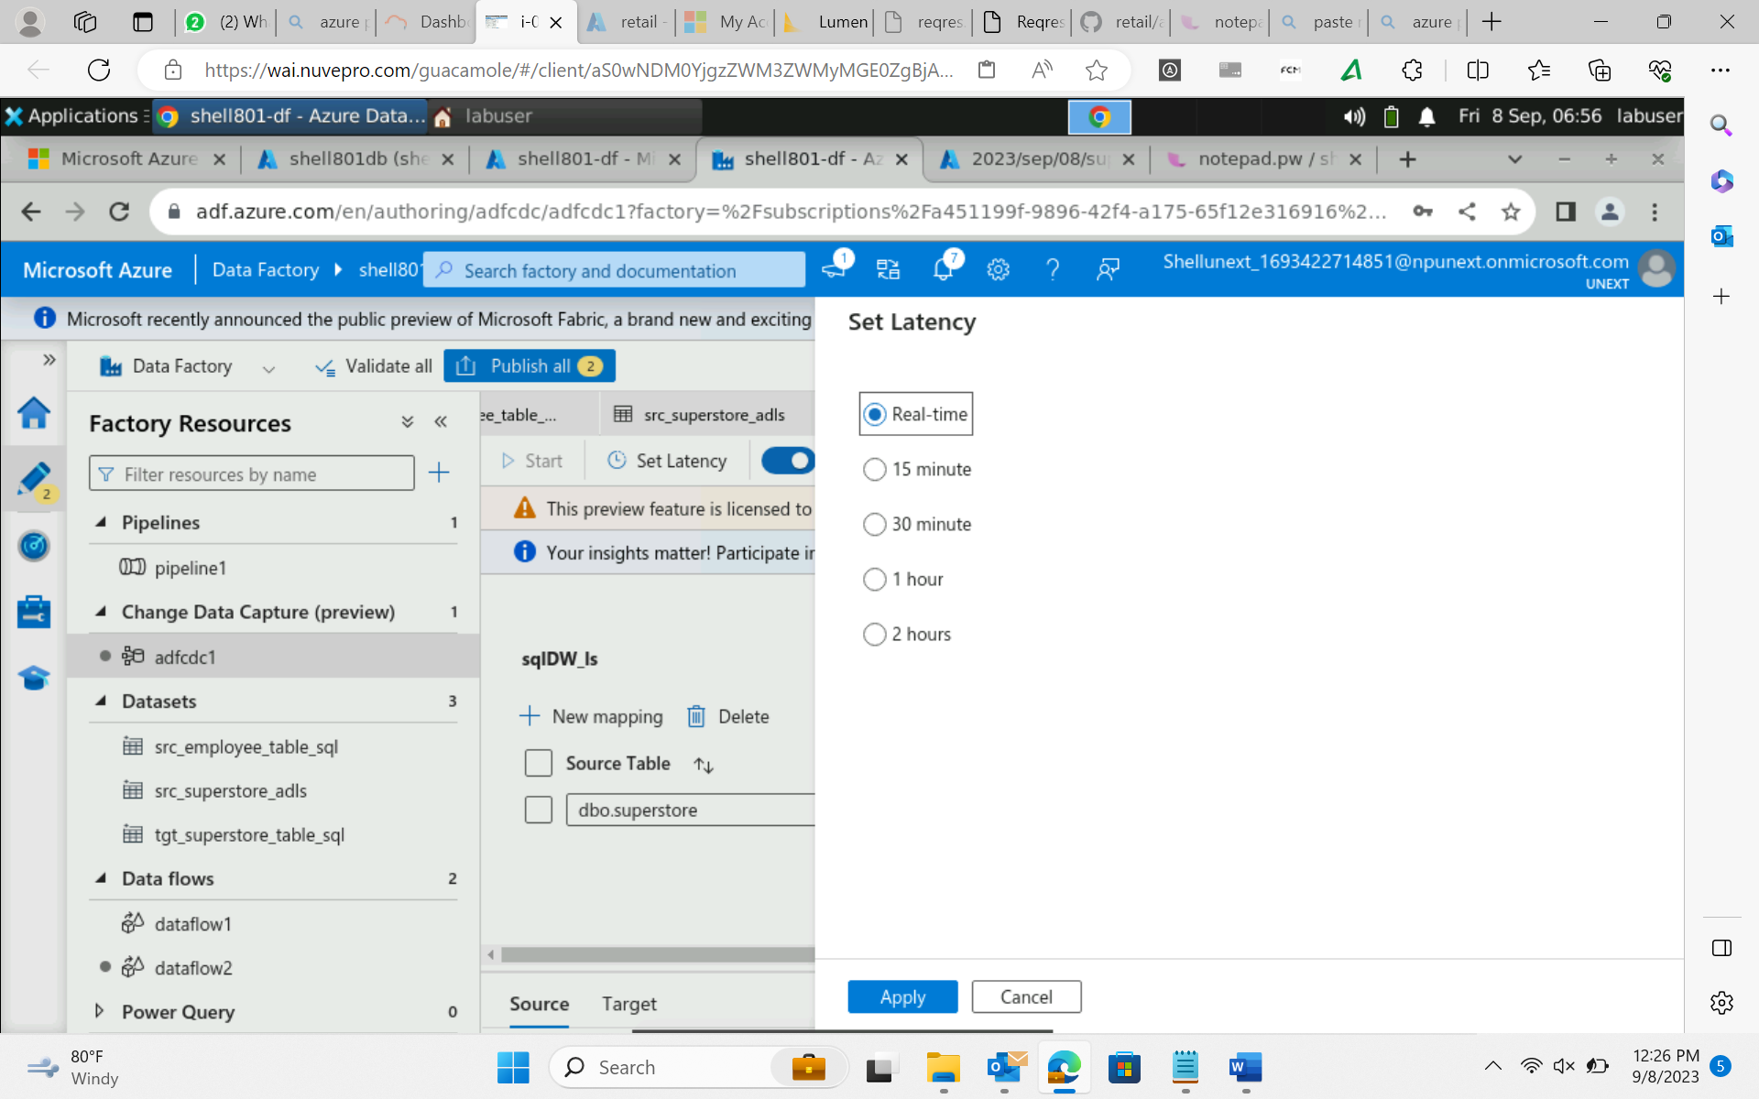
Day 16 : 8-Sep-23 (Friday) – Azure Data Factory
Change data capture (CDC) – in source if your data updates in real time.

Slide 19
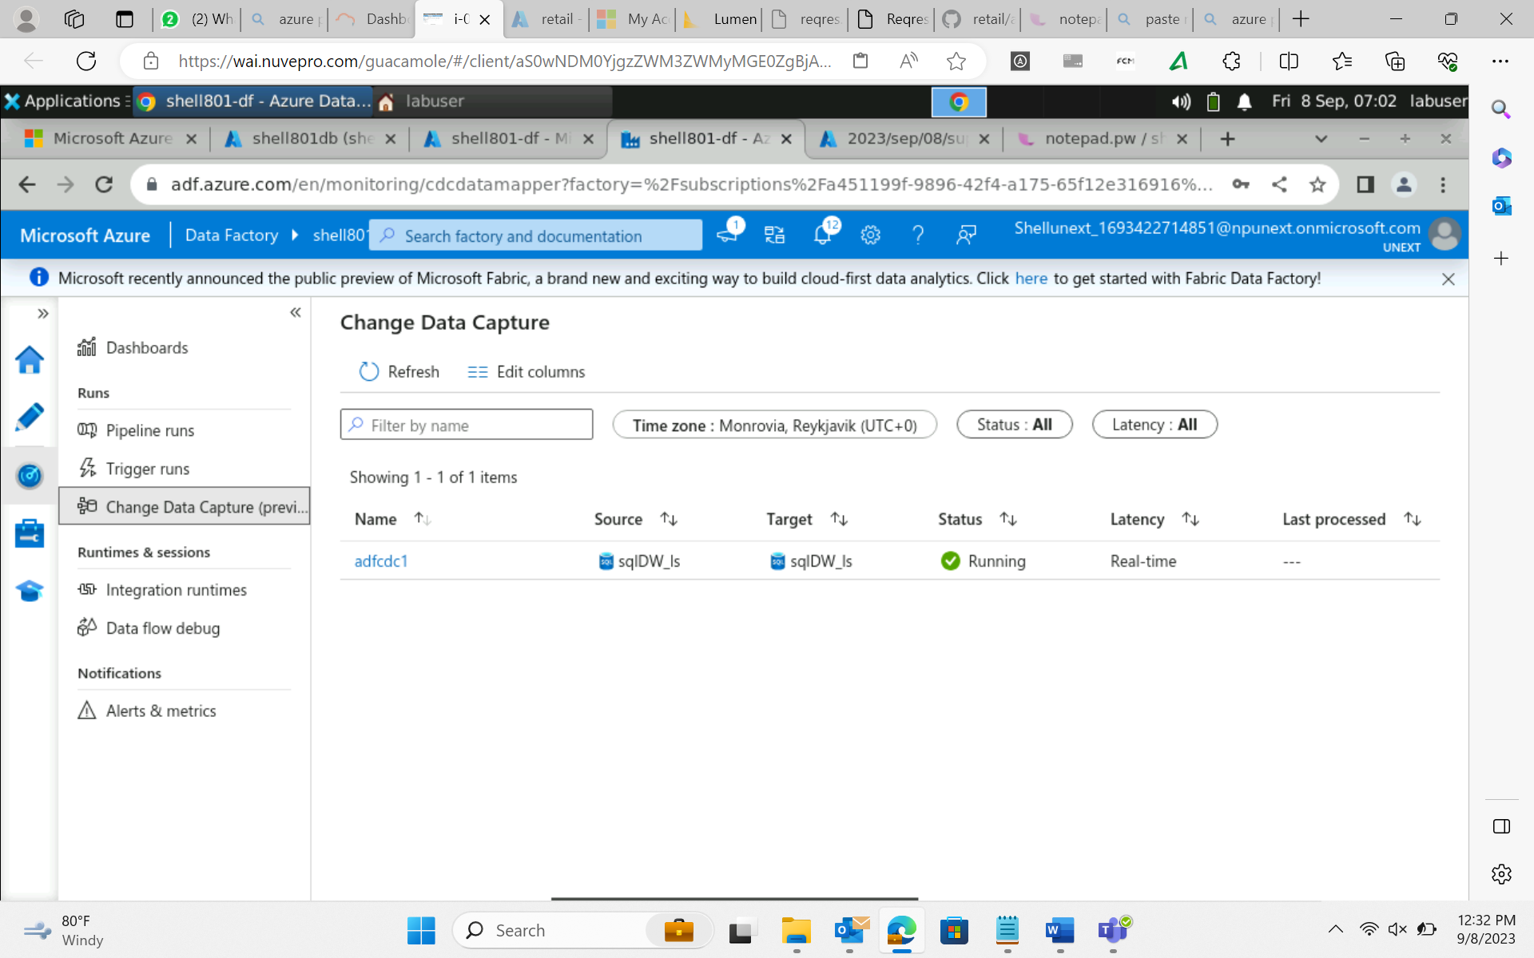
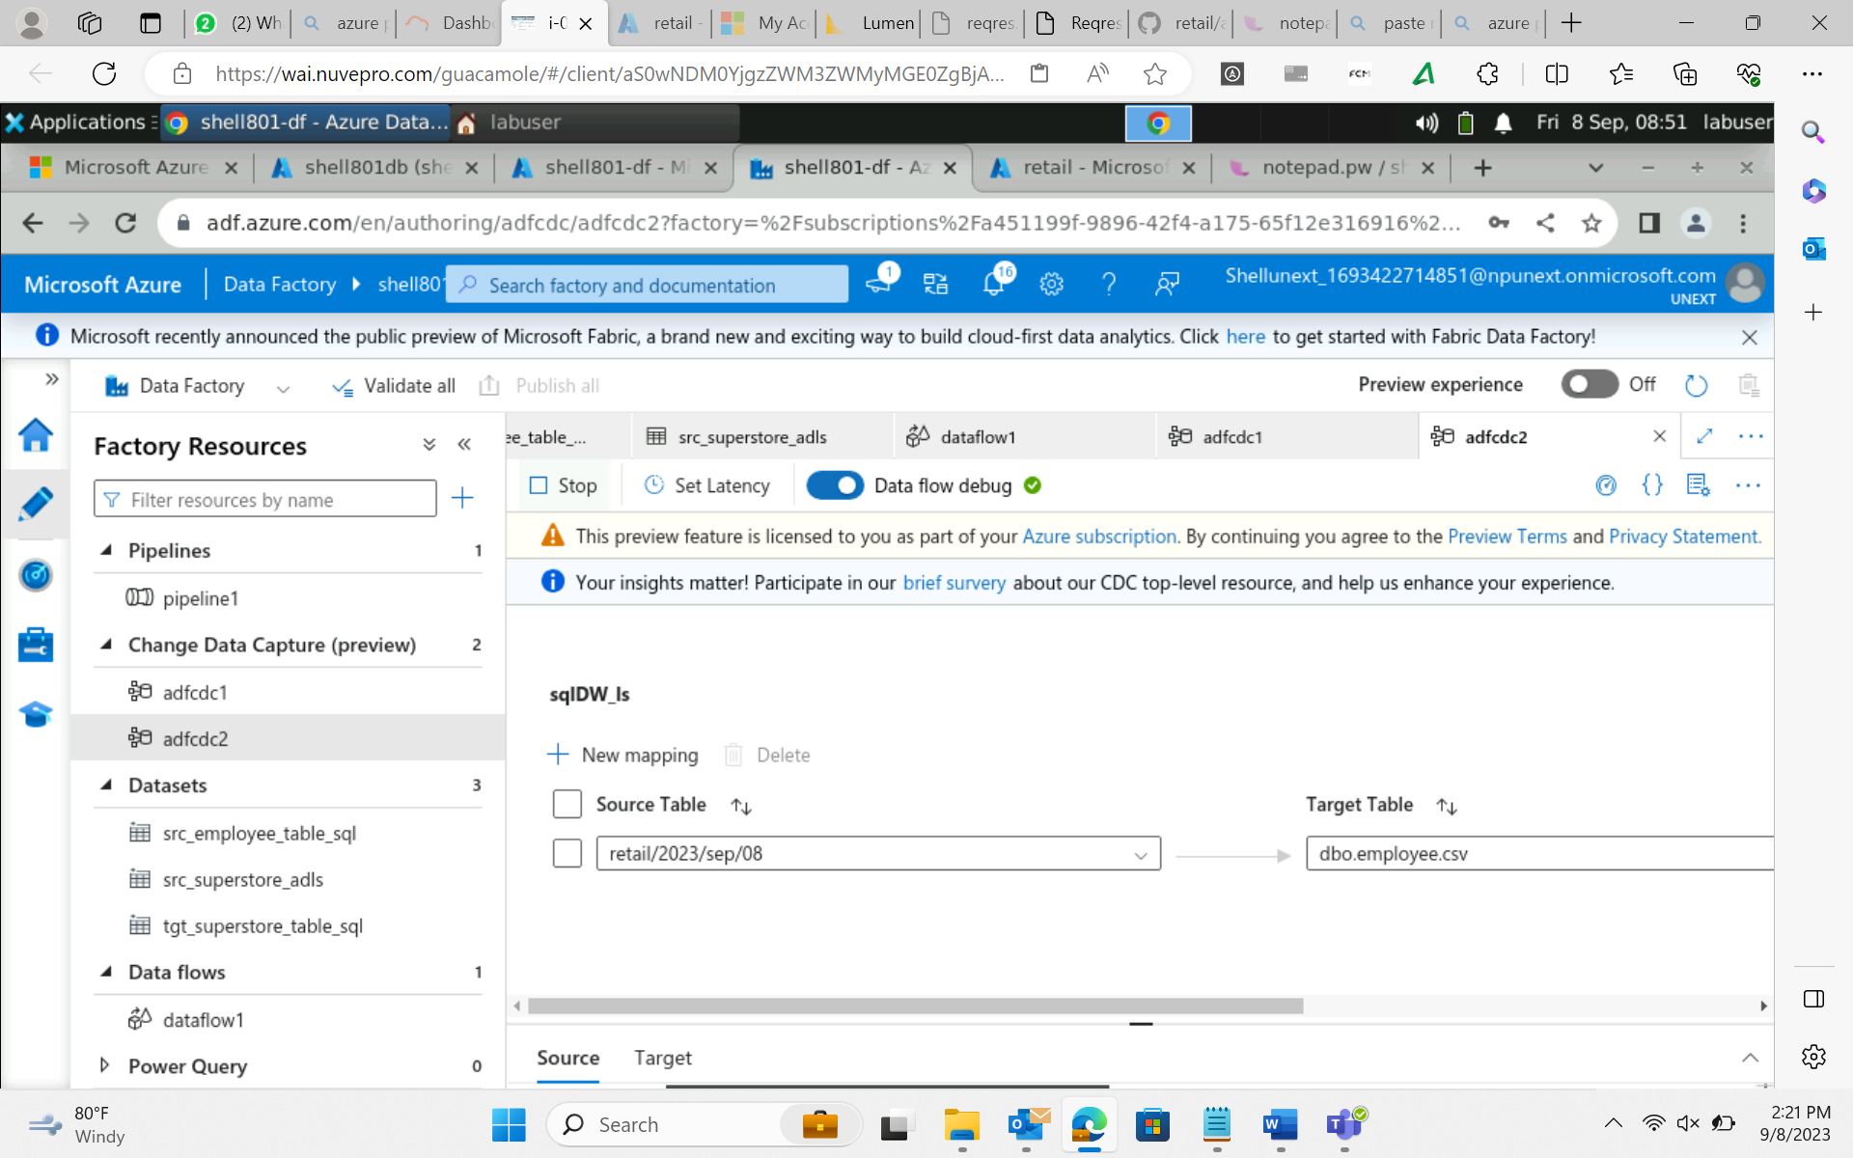
Day 16 : 8-Sep-23 (Friday) – Azure Data Factory
Change data capture (CDC) – in source if your data updates in real time.

Slide 20
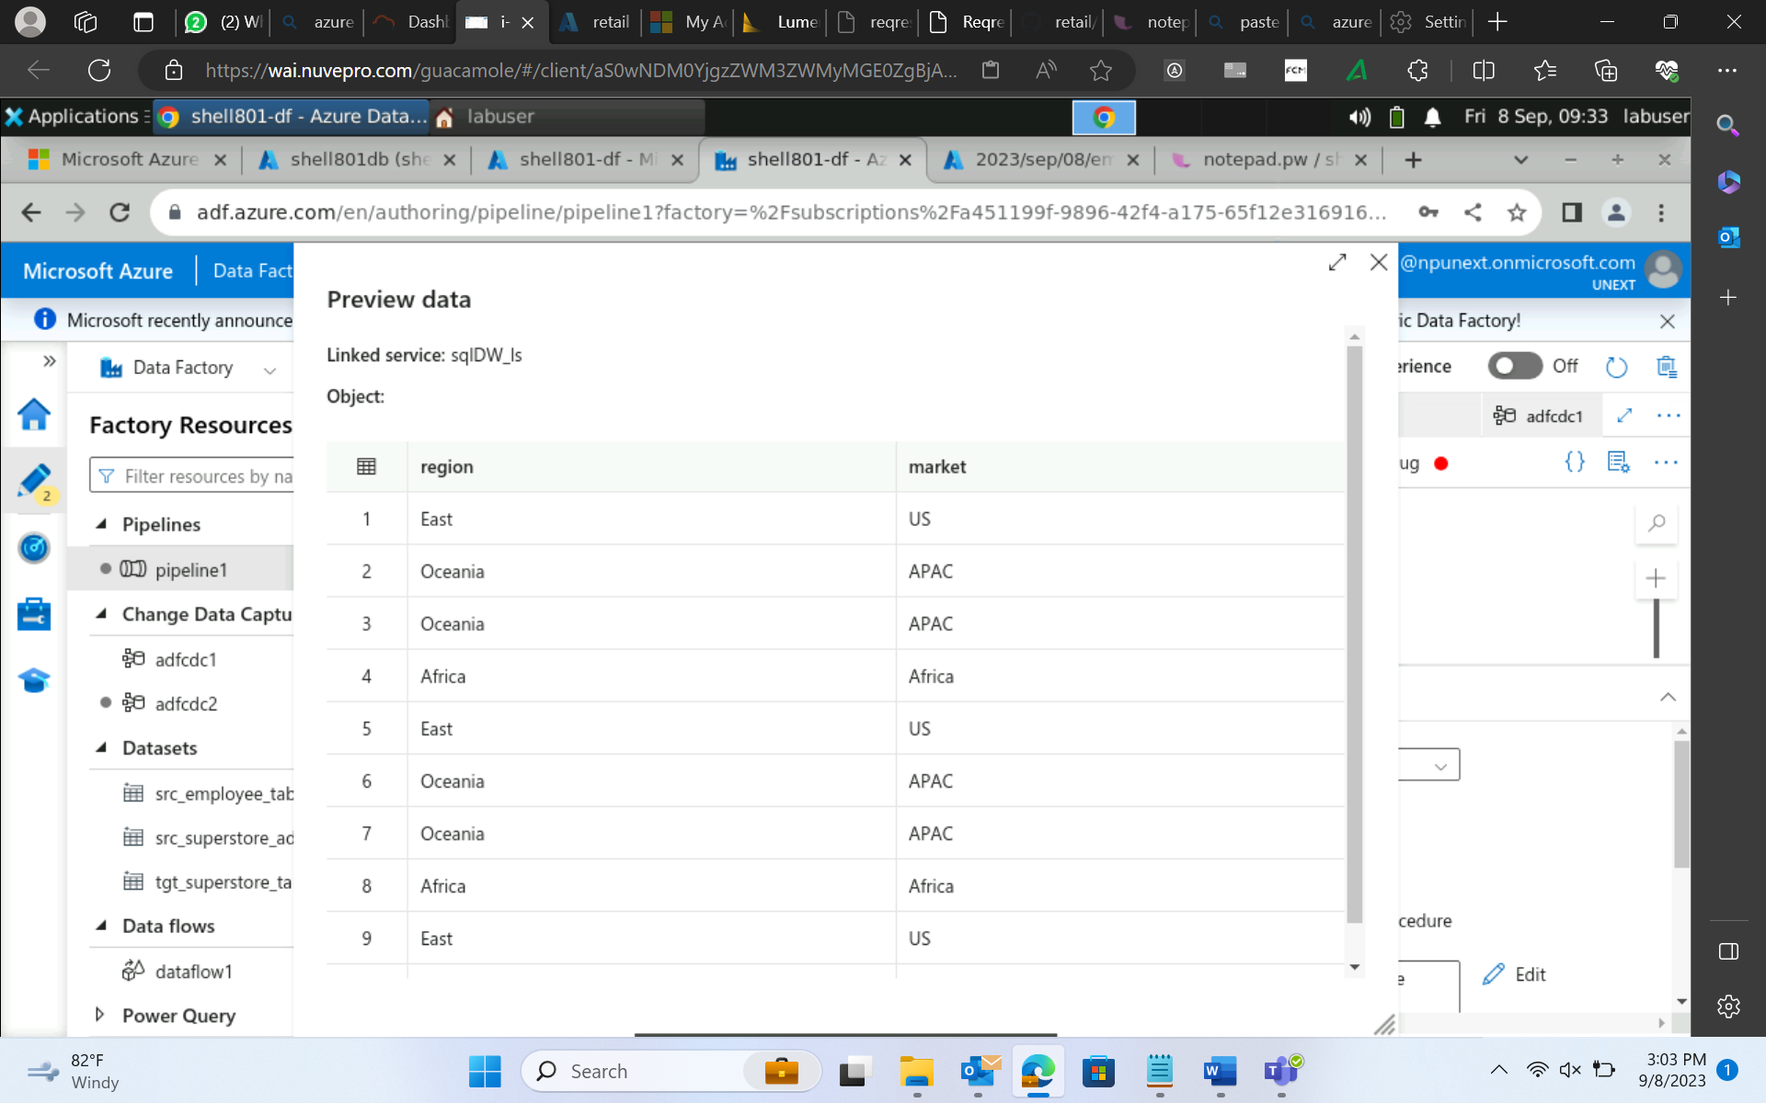
Day 16 : 8-Sep-23 (Friday) – Azure Data Factory
Lookup activity

